Slide 1
Units of Measure
Grade 9 Science

Slide 3
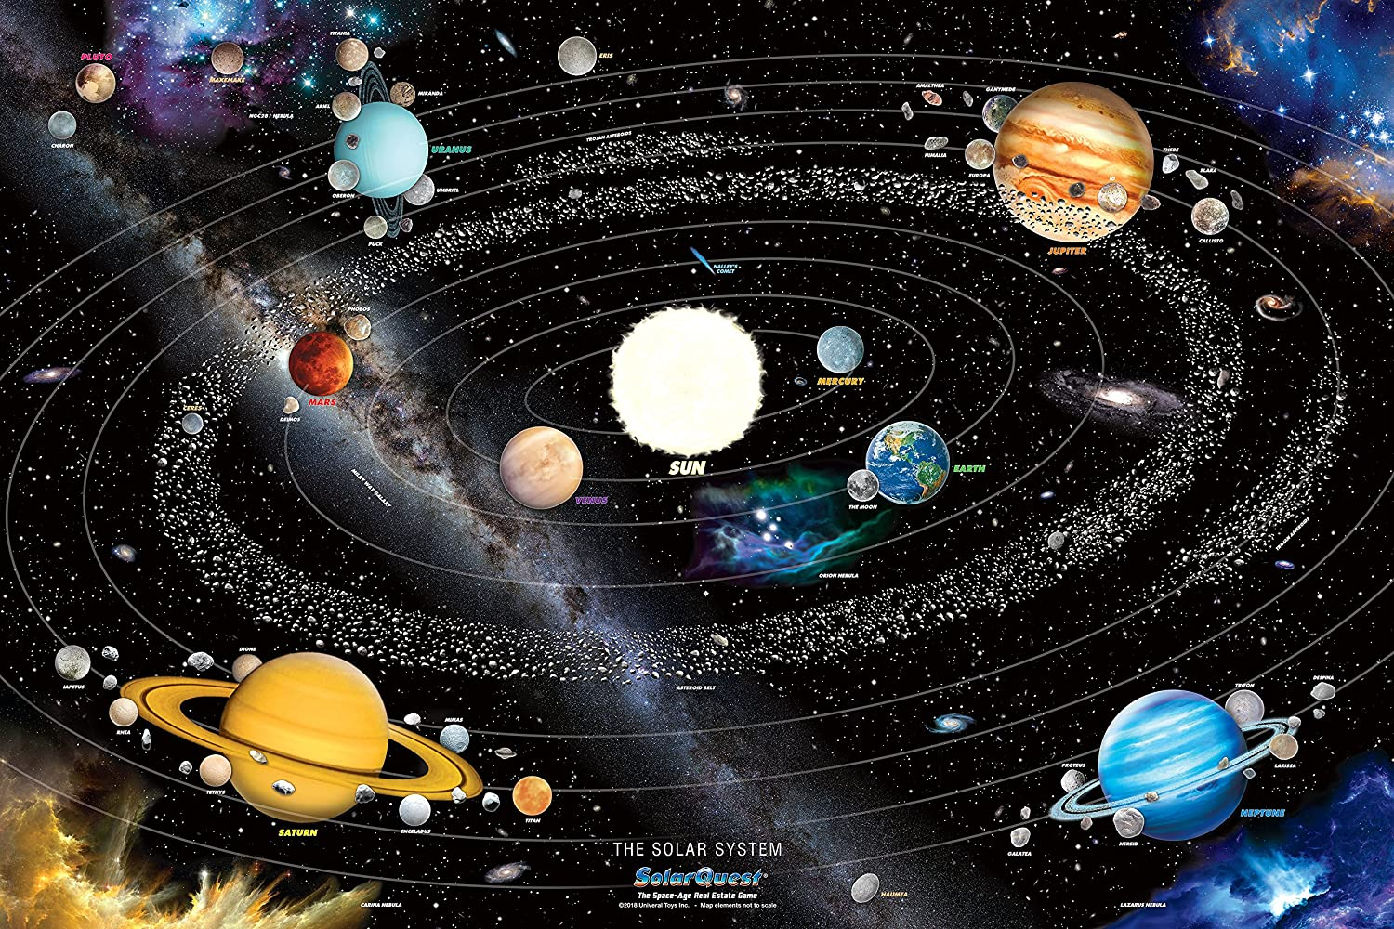

Slide 4
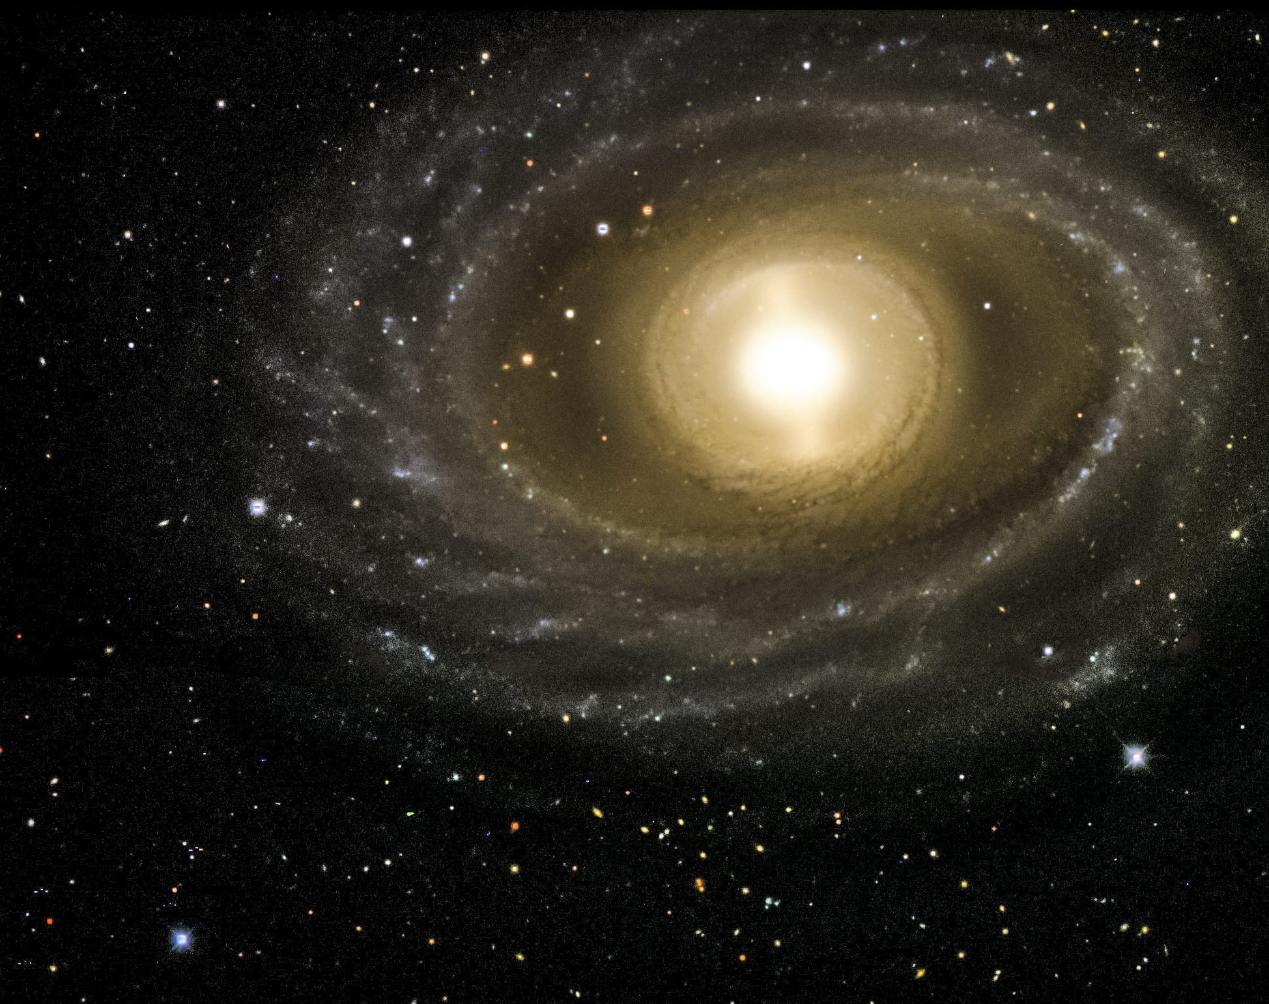
Why do we use other types of units in space?
*The universe beyond our Earth is so vast that we need to use units much larger than the ones we use on Earth
This helps us avoid having to constantly use large numbers or scientific notation when discussing distances
This Photo by Unknown Author is licensed under CC BY

Slide 6
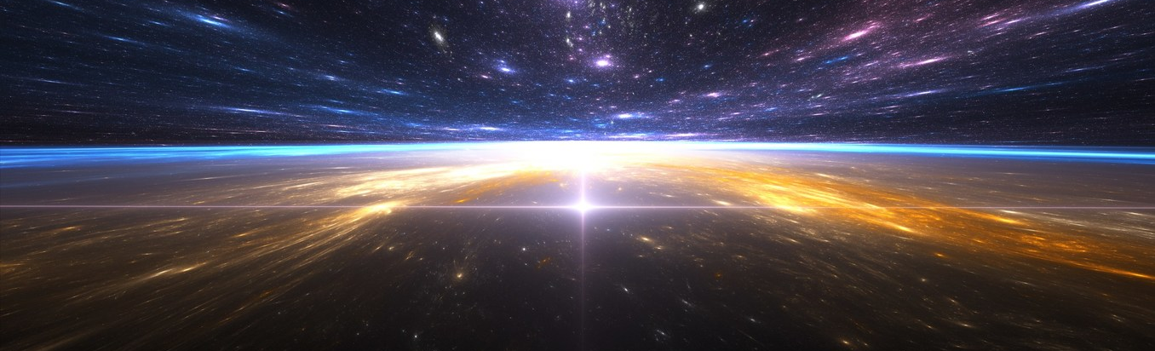
Light Year
A light year is not a unit of time, It is a unit of distance
*One light year is equivalent to the the distance that light travels in one year
The speed of light is approximately 300,000 km/s (1.08 billion km/h)
Therefore, the distance of one light year is 9.4607x10¹² km (9,460,700,000,000 km)
63242 AUs = 1 light year

Slide 7
Light year clip

Slide 8
Parsecs
A Parsec is an even larger unit of measure that we use when the number of light years between objects climb into the thousands or millions
Related to how astronomers measure widths in the sky using angles from earth
*One Parsec is equal to 3.26 light years

Slide 9
Astronomical Unit (AU) Calculations
1 AU = 150,000,000 kms
Ex1) Jupiter is 5.2 AUs from the sun. How far is this in kms?
__________
Ex2) Mars is 228,000,000 kms from the sun. How many AUs is this?
___________

Slide 10
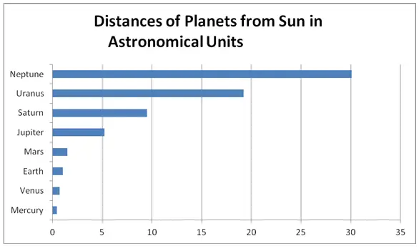
Astronomical Units is the best unit for measuring distances between planets or objects within our solar system.

Slide 12
Grain of Sand Video

