Slide 1
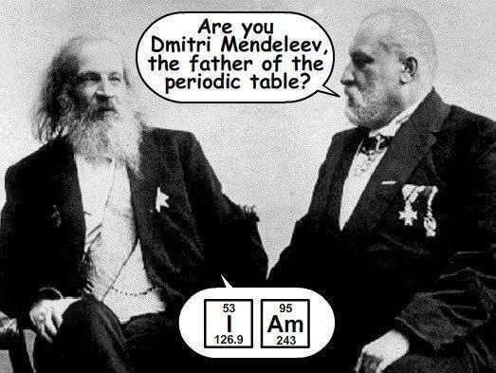
THE PERIODIC TABLE
- Dmitri Mendeleev (1869) organized elements by atomic mass into a table. He helped to establish families of elements.

Slide 3
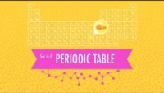

Slide 6
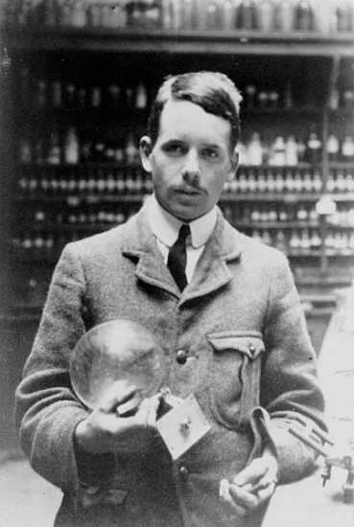
Harry Moseley (1901) revised the periodic table, arranging elements according to atomic number.

Slide 8
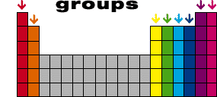
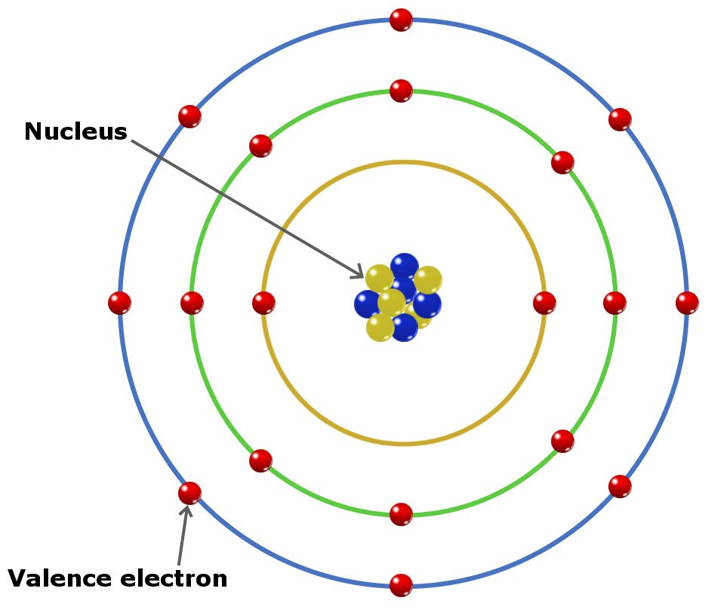
A group or a family is a vertical column containing elements with similar physical and chemical properties.
Families have the same number of electrons in their outermost shell/orbital (valence electrons).

Slide 9
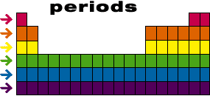
A period is a horizontal row
Periodic Law – Elements arranged according to atomic number show a reoccurring pattern of similar properties.

Slide 10
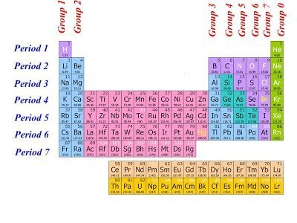

Slide 11
