Slide 1
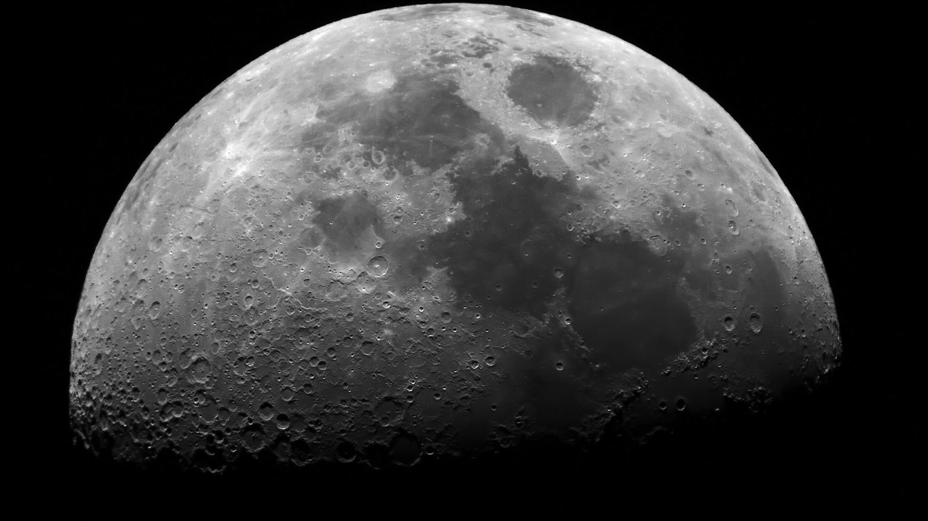
The Moon
Grade 9 Science

Slide 2
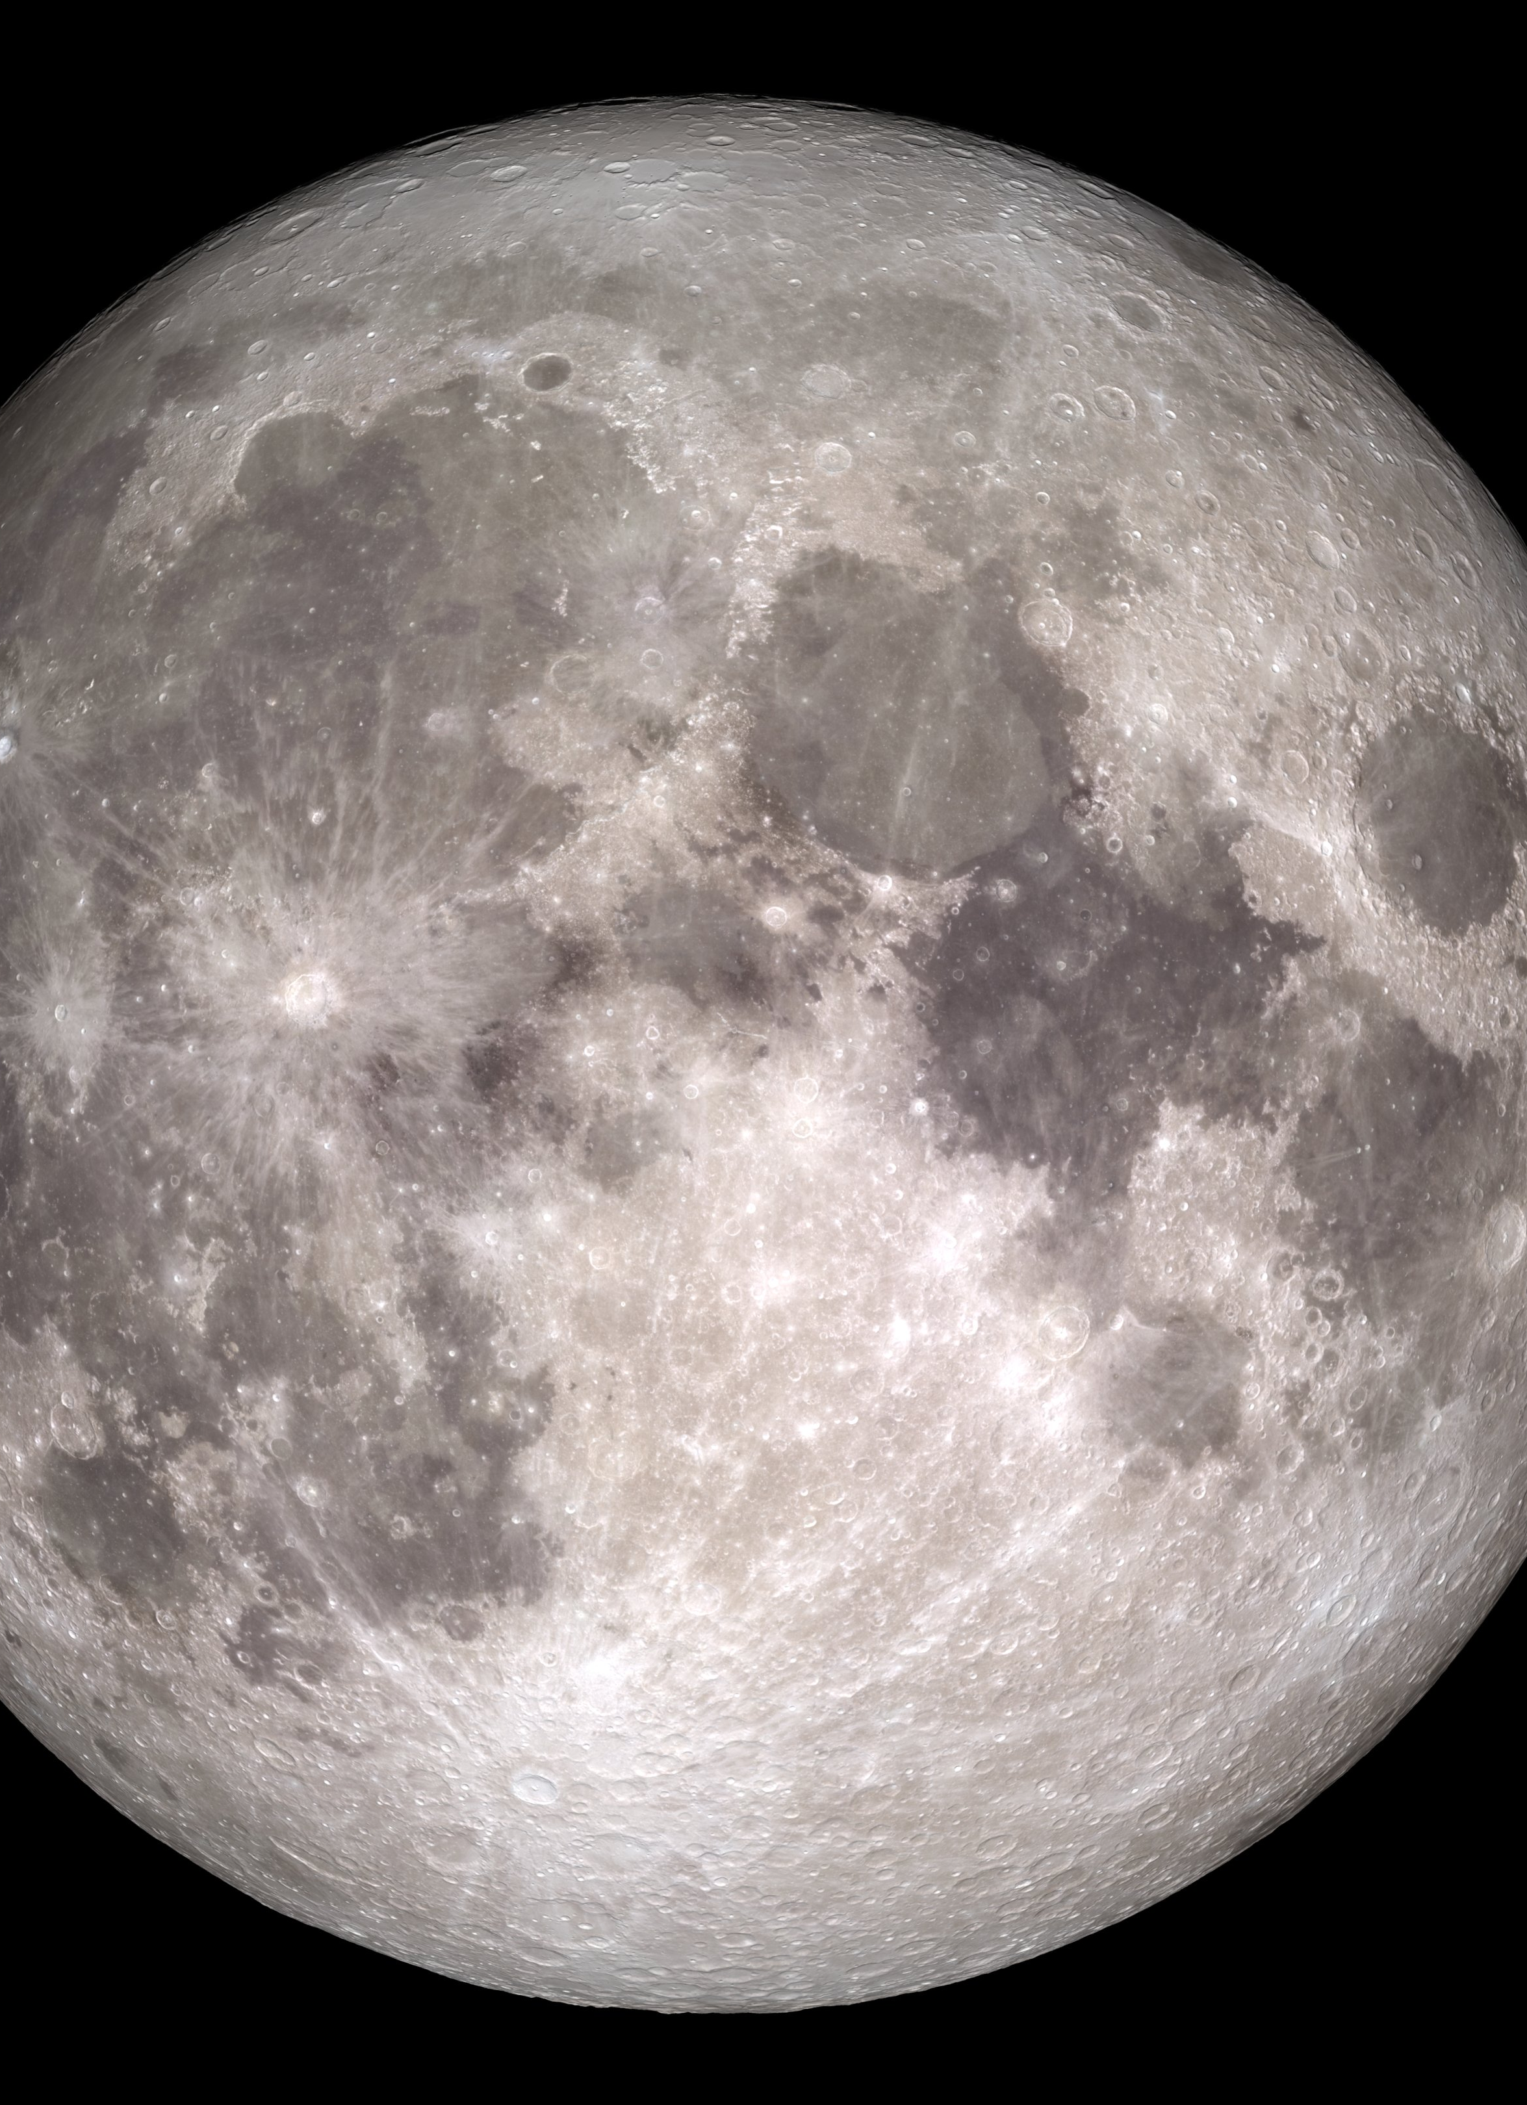
What is a Moon?
*A moon is defined as a celestial body that makes an orbit around a planet
Sometimes referred to as natural satellites
make sure you don’t confuse with human made satellites

Slide 3
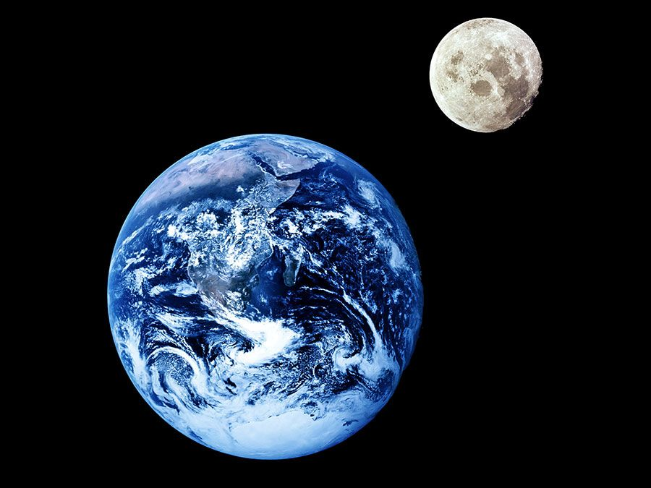
Earth’s Moon
Radius of the moon is 1,740 km
Radius is a measurement from the midpoint of a circle to the outer edge
*The moon appears to be the brightest object in our night sky, but this is simply due to how close it is to us
Average distance of 384,400 kms away from earth but varies between 362,600 km and 405,400 km
Therefore, eccentricity is 0.0549 (12% difference in distance)
Meaning it is more elliptic than earth’s orbit

Slide 4
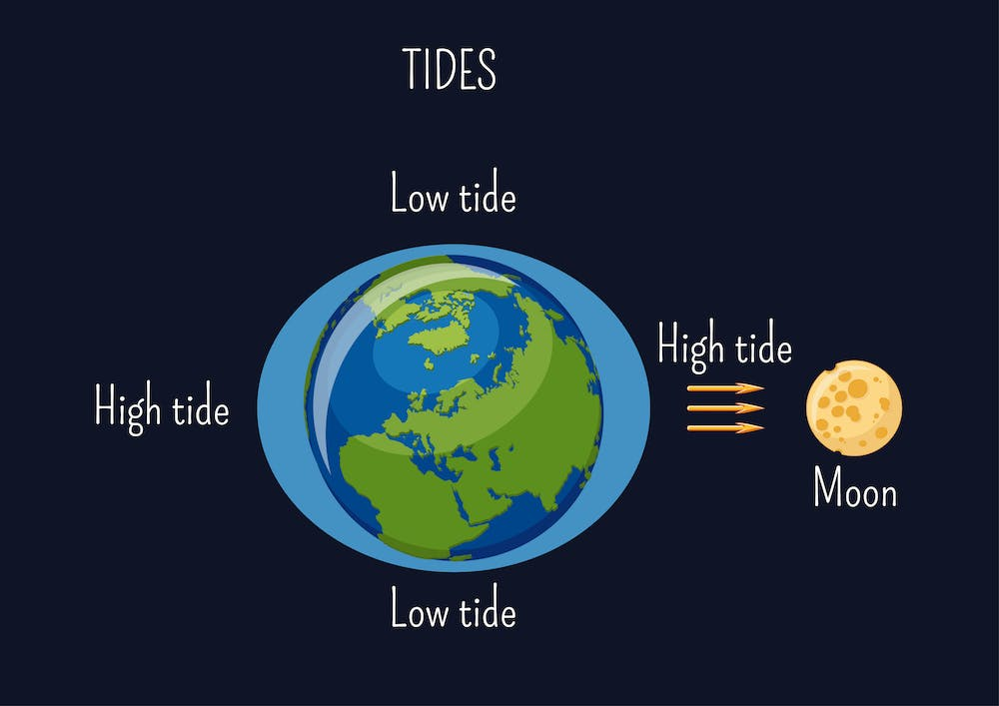
Moon’s Effect on Ocean Tide Level
-*On Earth, the Moon's gravitational pull causes the oceans to bulge out on both the side closest to the Moon and the side farthest from the Moon.
-These bulges create high tides. The low points are where low tides occur

Slide 5
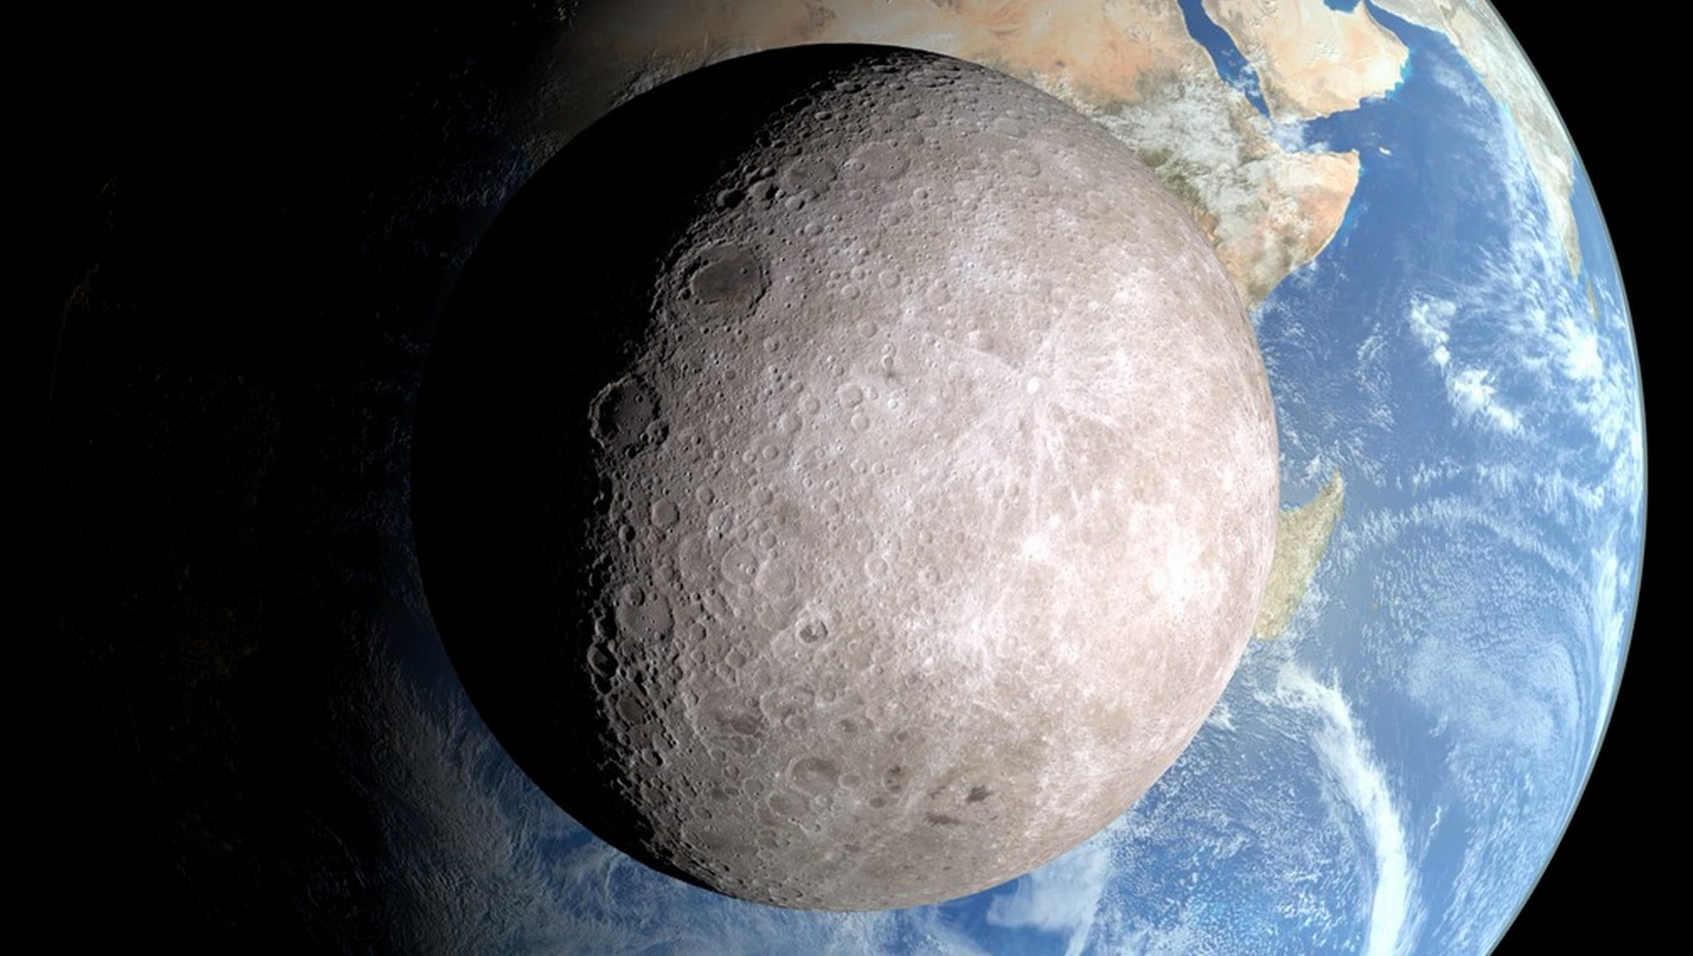
Synchronous Rotation of our Moon
Synchronous Rotation of our moon- This simply refers to how our moon spins on its axis at the exact same rate that it orbits earth
This causes us to only ever see one half of the moon
Hence the term “The Dark Side of The Moon”
Clip

Slide 6
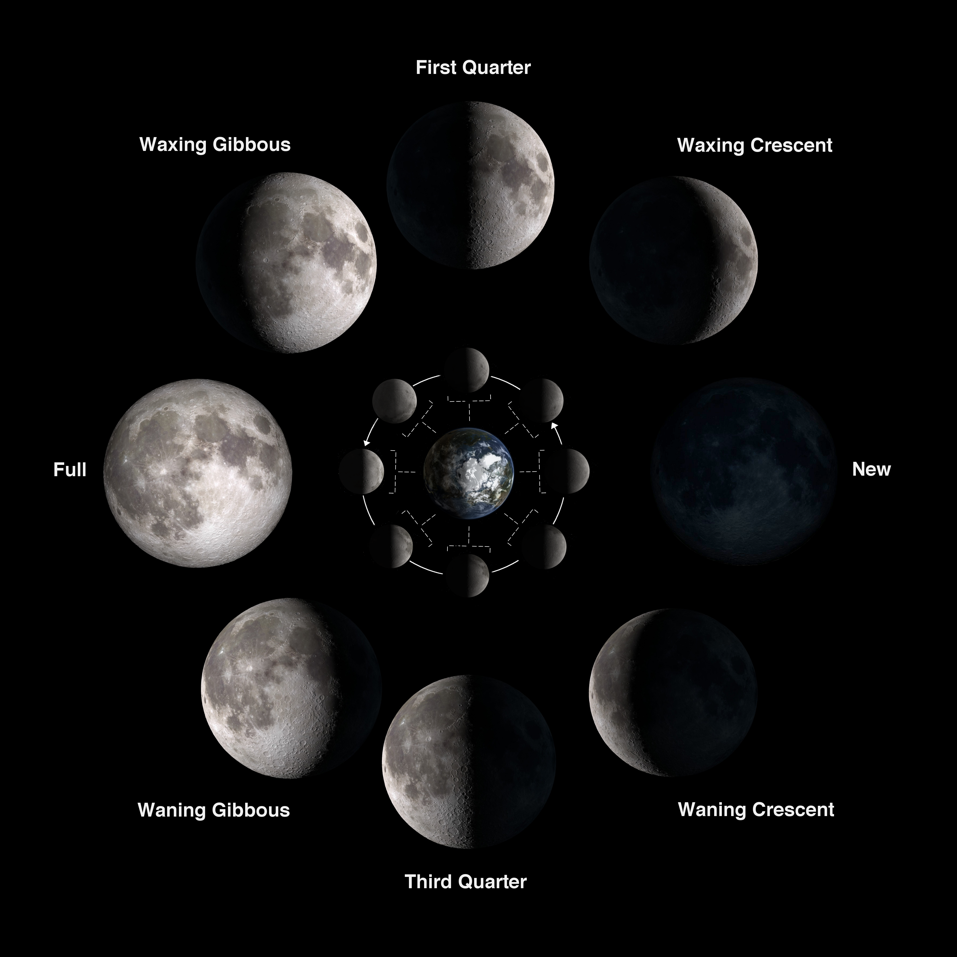
Moon’s Orbit/Cycle
The moon orbits the earth every 27 days however its lunar cycle (how it appears to us on earth) is 29.5 days
*During a lunar cycle, there is 8 distinct phases

Slide 7
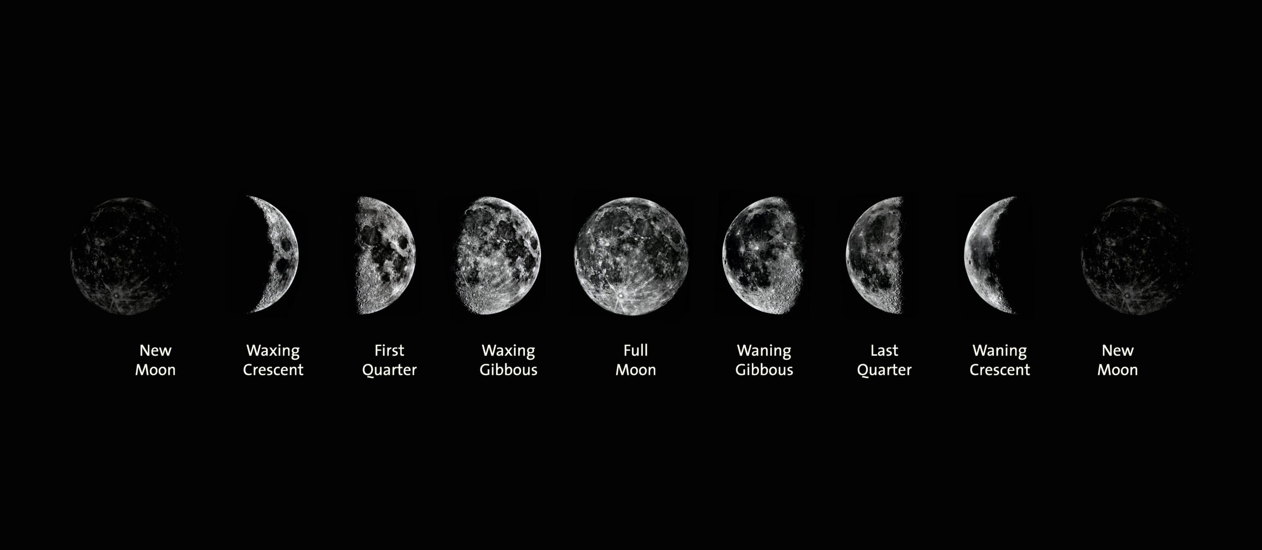
Lunar Phases
The lunar phases in order are:
new Moon, waxing crescent, first quarter, waxing gibbous, full Moon, waning gibbous, third quarter and waning crescent.

Slide 8
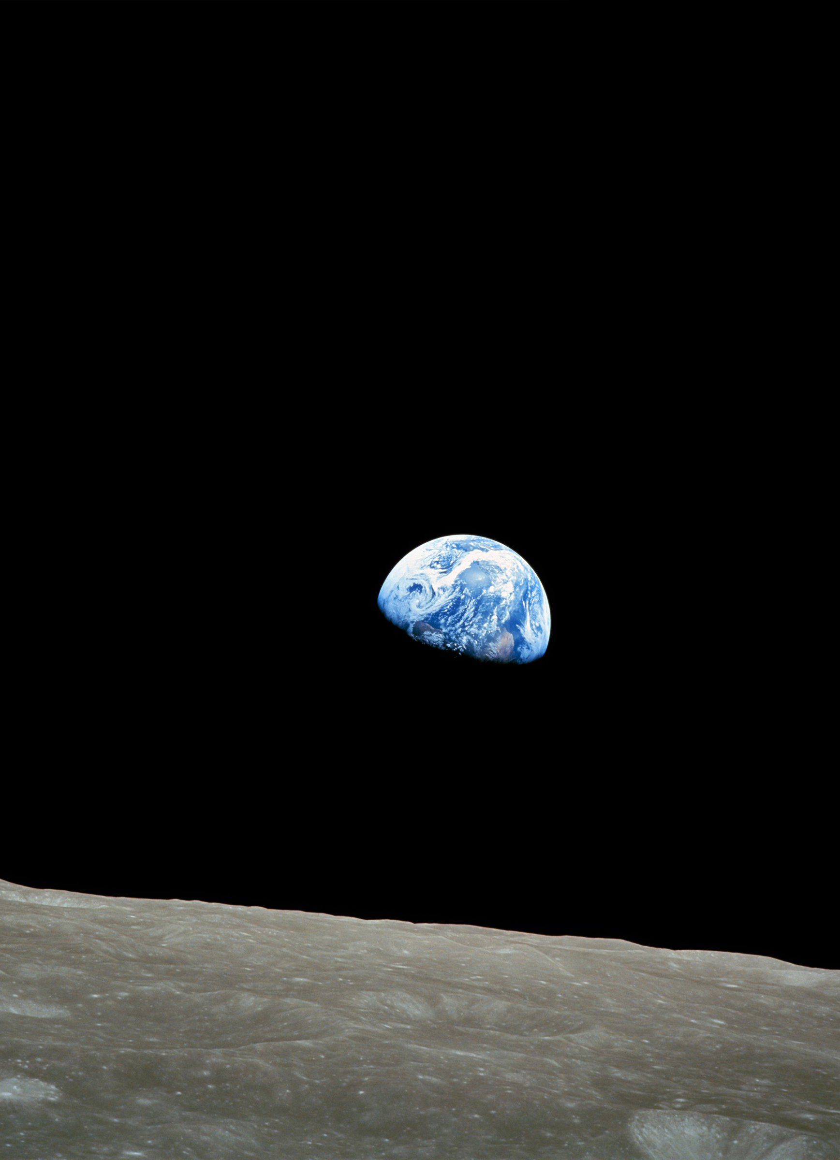
What causes the phases of the moon
It is a common misconception that the moon’s phases are caused by the earth blocking the suns light and casting a shadow on a portion of the moon.
This is False!
The moons phases are caused by our perception of the moon’s illumination or reflection of the suns light
It’s the same concept of how only half of the earth is lit or illuminated by the sun at one point (day and night)

Slide 9
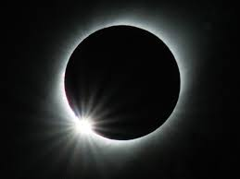
Eclipse
An eclipse can be defined as the blocking of light from one celestial object due to the passing of another
*Lunar Eclipse- when the earth’s shadow blocks or obscures the moon
Occurs about 3 times a year
*Solar Eclipse- when the moon’s shadow blocks or obscures the sun
Occurs bout once every 18 months somewhere on the earth, but approximately once every 375 years from any given point on earth

Slide 10
Lunar Eclipse Video Solar Eclipse Video

Slide 11
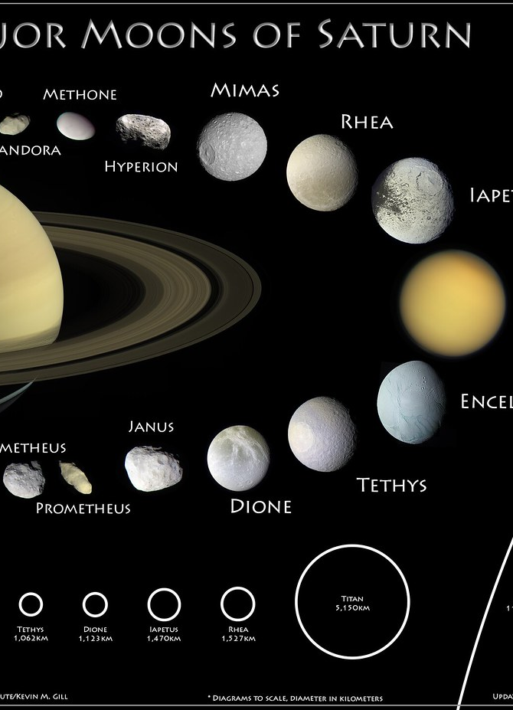
Other “Planets” with moons
Many planets in our universe have moons orbiting them and this is because of the gravitational force the planet has on its moon
Within our solar system:
Saturn- 83 moons
Jupiter- 95 moons
Uranus- 27 moons
Neptune- 14 moons
Pluto- 5 moons
Mars- 2 moons

