Slide 1
The Discovery of the Cell

Slide 2
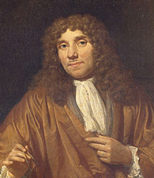
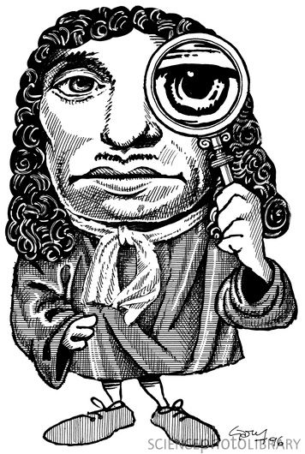
Anton van Leeuwenhoek (1632-1723)

Slide 3
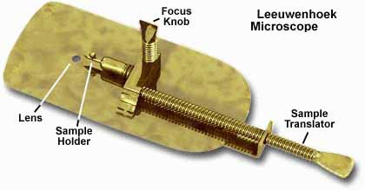
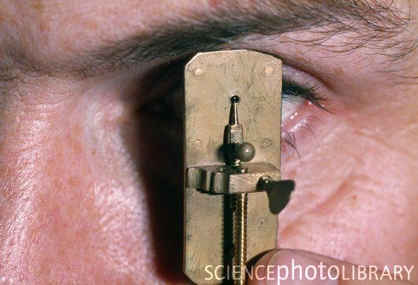
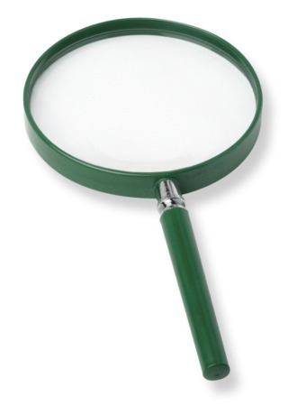
Made simple microscopes which magnified objects up to 300 times their actual size.

Slide 4
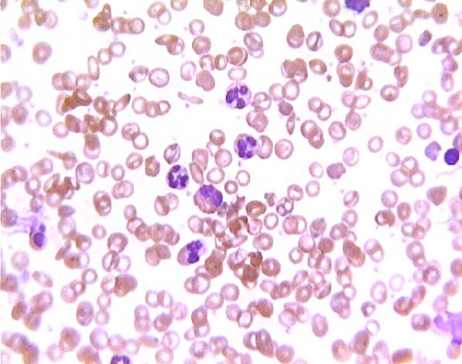
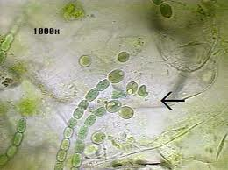
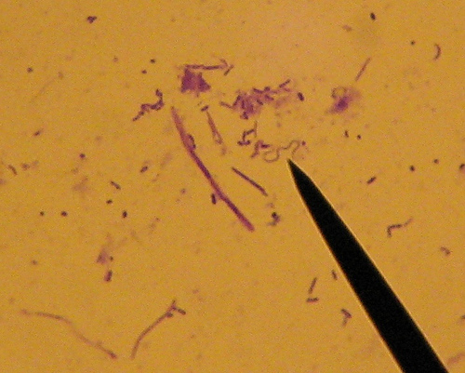
Used them to look at blood, pond water, and matter scraped from teeth.
First person to observe single-celled organisms
Called them animalcules

Slide 5
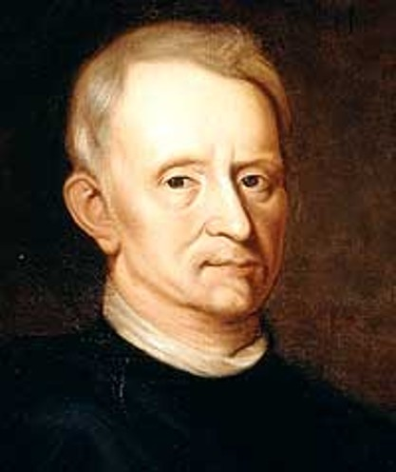
Robert Hooke (1635-1703)

Slide 6
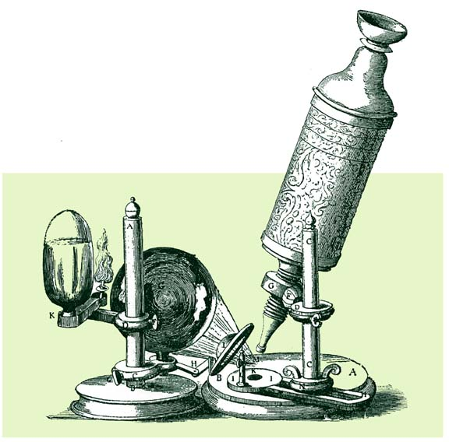
About the same time as van Leeuwenhoek, Hooke was experimenting with microscopes he built

Slide 7
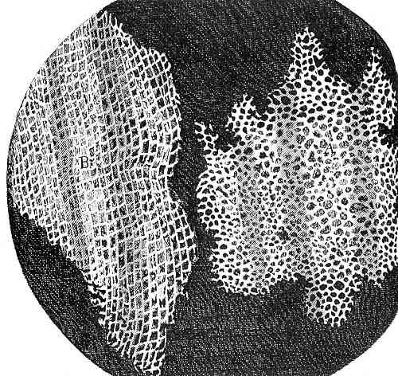
Hooke observed a piece of cork and saw a network of boxlike compartments
described boxes as cellulae meaning small rooms in Latin
this is where our present day term cell comes from.

Slide 8
Over the next century, scientists used microscopes to study microorganisms and observed cells in every living thing examined
In 1839, botanist Mathias Schleiden and zoologist Theodore Schwann combined observations and made the observation that all living things are made of cells and that the cell is the most basic unit of life.

Slide 9
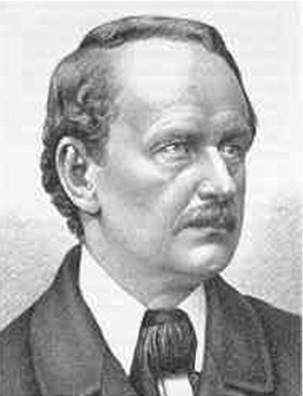

Slide 10
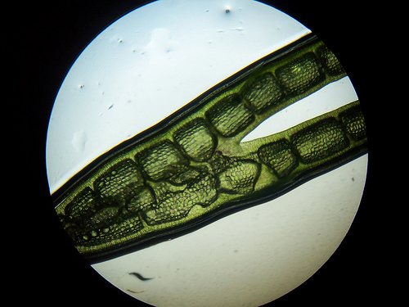
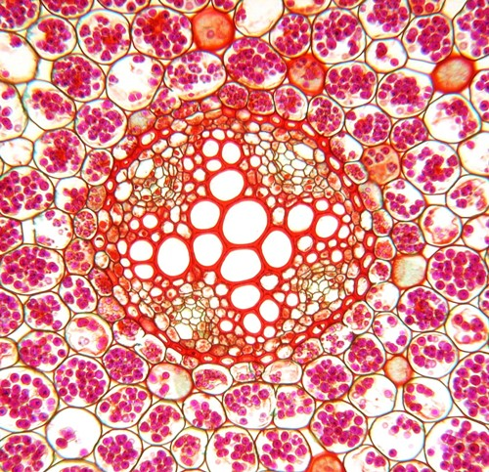
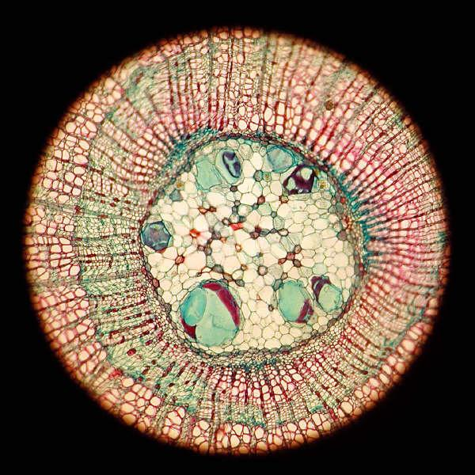
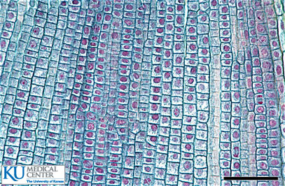

Slide 11
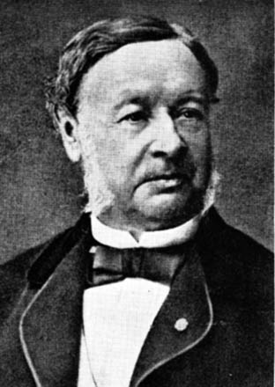

Slide 12
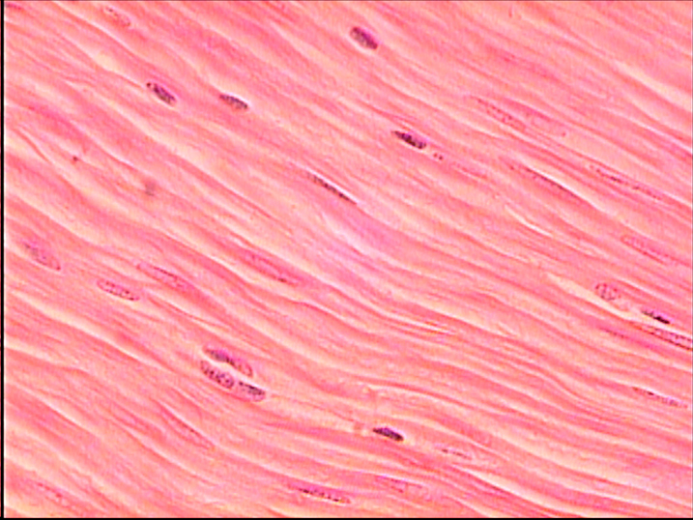
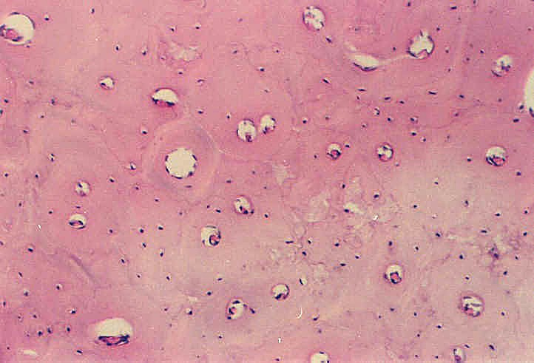

Slide 13
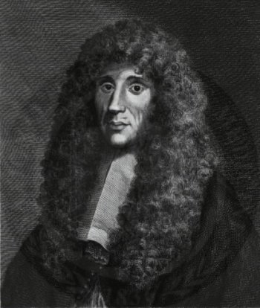
Before the discovery of the cell, it was believed that living organisms came from non-living matter such as air or water.
This idea was known as spontaneous generation
Then, in the late 17th century, Francesco Redi carried out controlled experiments to demonstrate that maggots came from tiny eggs laid on rotting meat by flies

Slide 15
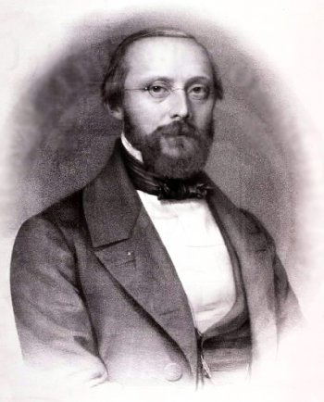
Eventually led to the idea suggested by Rudolf Virchow that life can only be produced by other life
All of these scientists ideas, when looked at together, led to what is known as the cell theory.

Slide 16
The Cell Theory
All living things are composed of one or more cells
All cells come from other living cells
The cell is the basic unit of life
The wellness of an entire organism is dependant on the wellness of it’s individual cells
i.e. You are only as strong as your weakest link!

