Slide 1
Sexual Reproduction

Slide 2
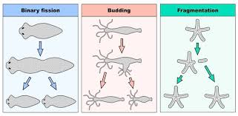
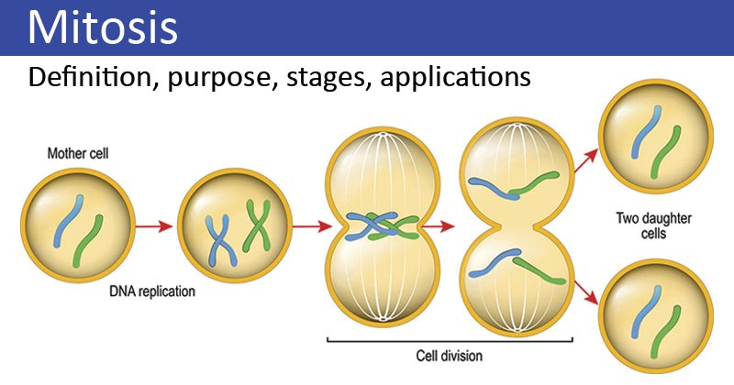
We saw that with mitosis and asexual reproduction, the offspring produced were identical to their parent

Slide 3
Differences observed among family members suggested to scientists that a different process was at work.
Discovered the process was sexual reproduction
Sexual Reproduction usually involves 2 individuals, a male and a female

Slide 4
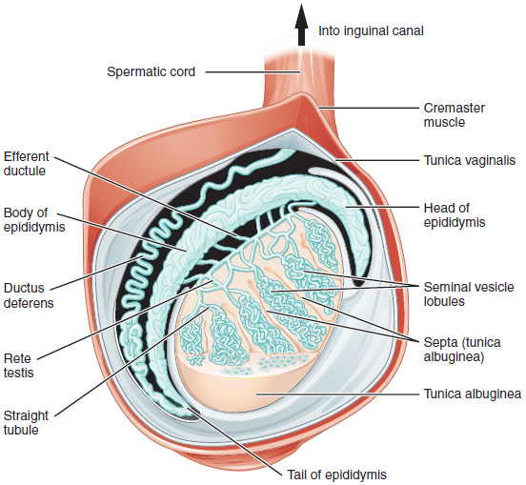
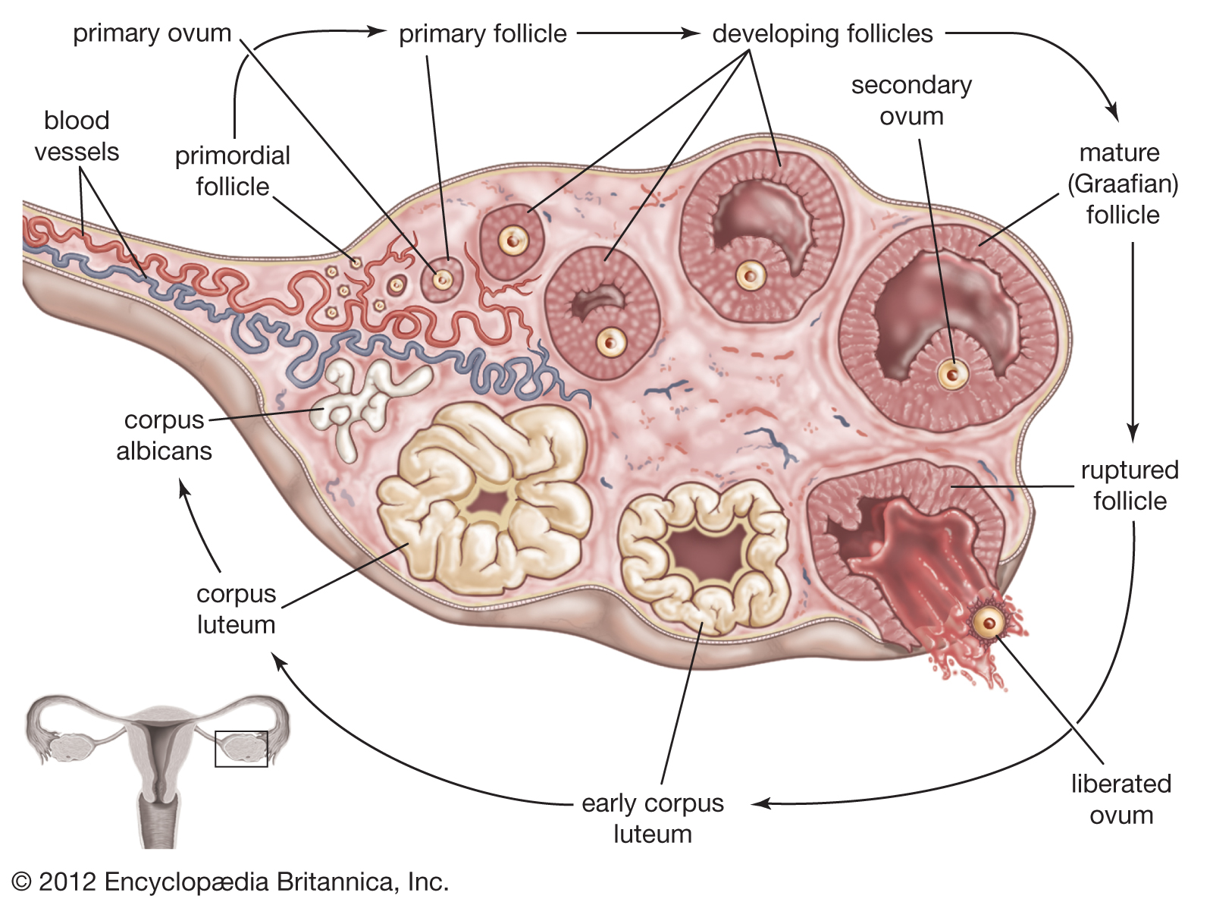
Your body has specialized organs called gonads that make specialized cells known as gametes
In males, the testes produce sperm
In females, the ovaries produce
eggs

Slide 5
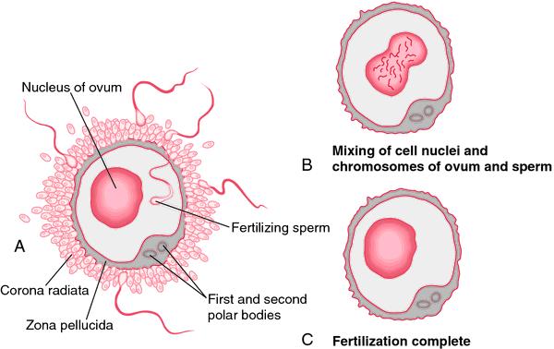
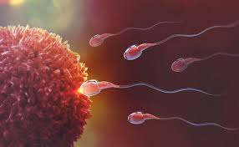
In sexual reproduction the gametes from a male and a female combine during an event known as fertilization to form a new cell known as a zygote (a single diploid cell)

Slide 6
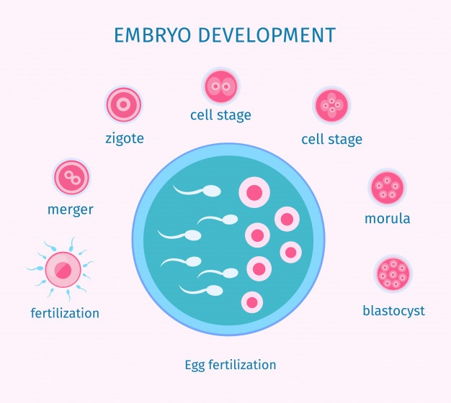
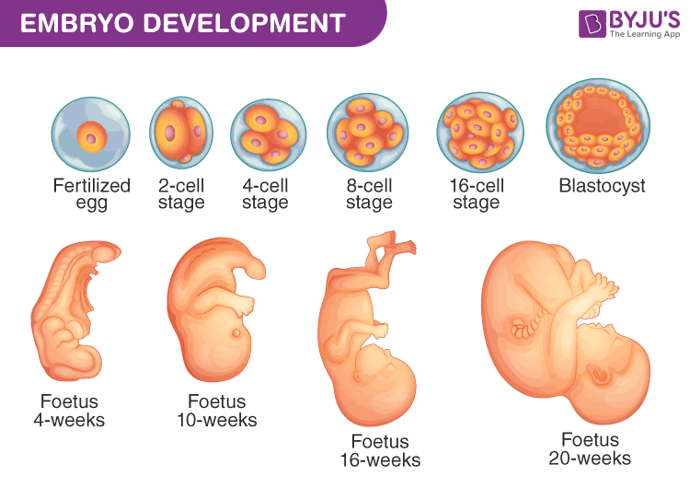
The zygote then undergoes mitotic divisions to turn into a multicellular organism
Mitosis ensures that the chromosome number does not change

Slide 7
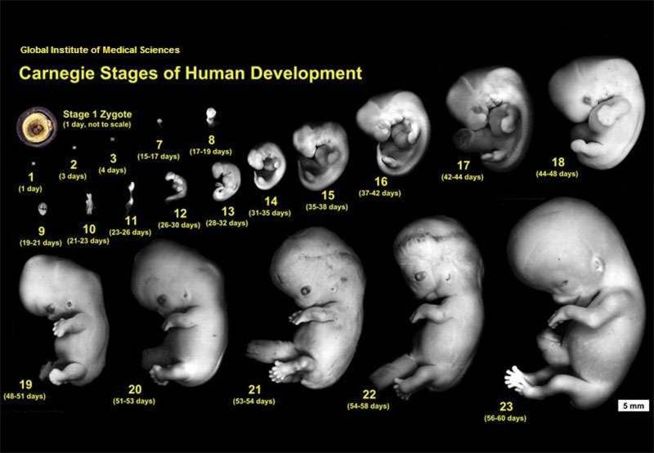

Slide 8
Meiosis

Slide 9
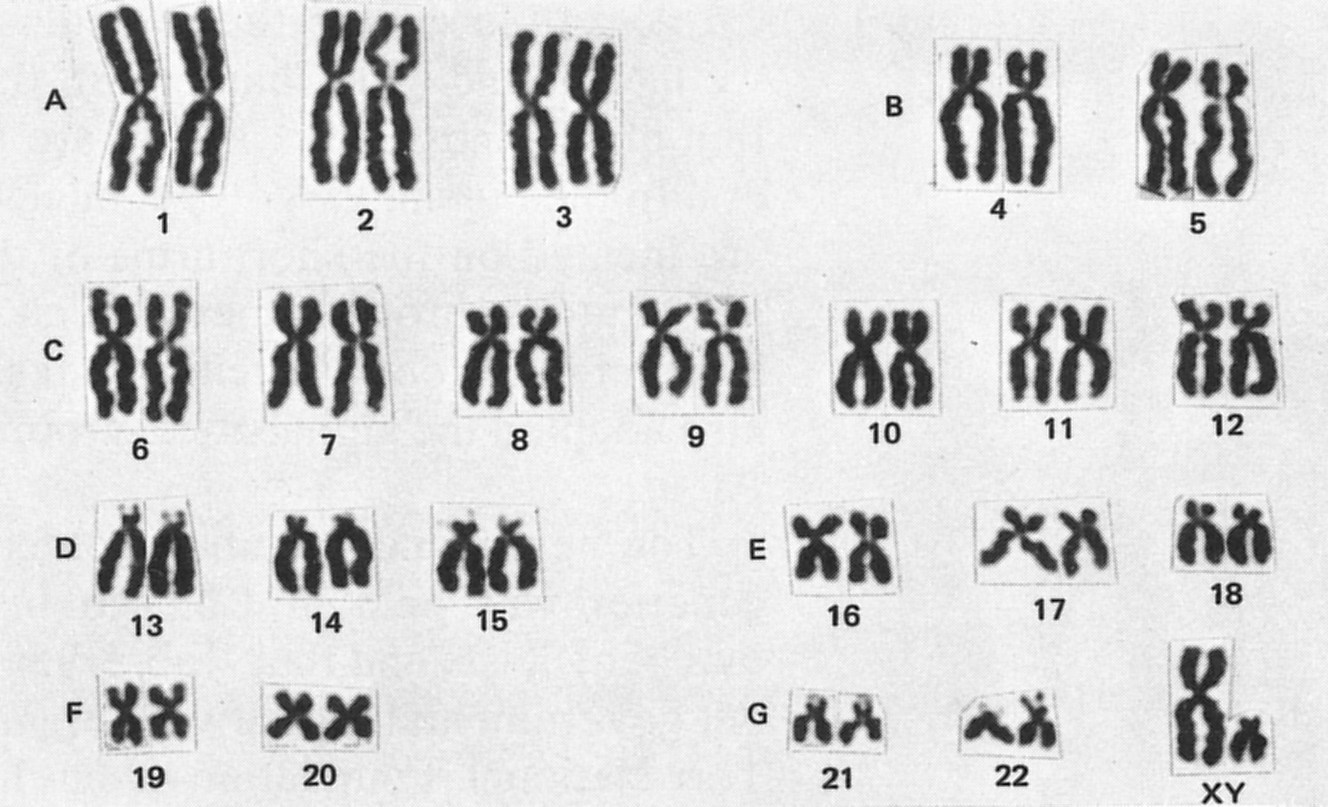
Recall that your 46 chromosomes are arranged in 23 pairs
The matching pairs are known as homologous pairs
One of each pair is from your mom, one from your dad

Slide 10
In order for the human chromosome number to remain at 46, gametes must have half the number of chromosomes the body cells have
Meiosis is the process that ensures each gamete contains only one-half set of chromosomes – ie. they are haploid

Slide 11
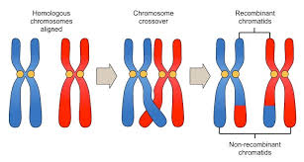
Meiosis also ensures that each gamete has a different combination of the chromosomes that were present before meiosis through a process known as crossing over
Crossing over ensures variation

