Slide 1
Physical and Chemical Changes

Slide 2
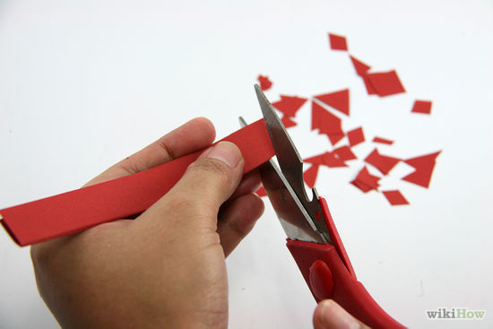
Physical and Chemical Changes
During a physical change, the substances remain the same even though it may change state or form (shape).

Slide 3
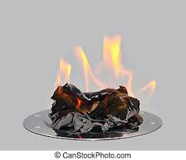
During a chemical change the original substance is changed into 1 or more different substances that have different properties. The number and type of atoms stay the same, but they are rearranged, so the products are different substances than the reactants you started with.

Slide 4
Chemical Change
The following may be indicators that a chemical change has taken place (however any one might also indicate a physical change):
Bubbles of gas

Slide 5
Chemical Change
Heat gain or loss

Slide 6
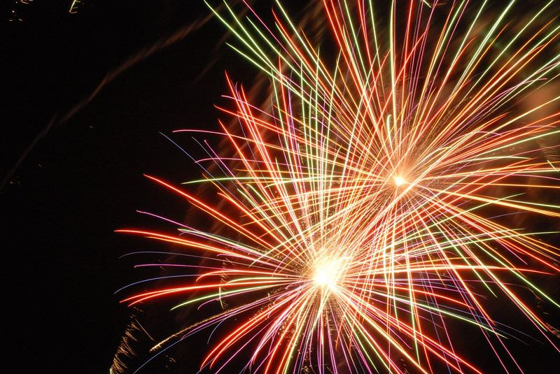
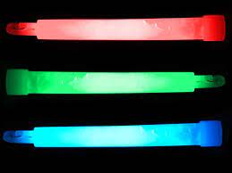
Chemical Change
Light emission

Slide 7
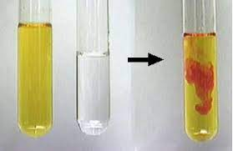
Chemical Change
Colour change

Slide 8
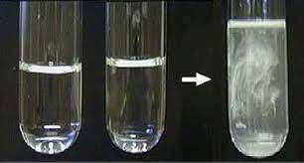
Chemical Change
Formation of a precipitate (a solid that forms in a liquid)

Slide 9
Chemical Change
Production of a new substance
Changes in properties of reactants
Changes that are difficult to reverse

Slide 10
https://www.youtube.com/watch?v=x49BtB5dOwg
https://www.youtube.com/watch?v=FOeH29hlHlU

