Slide 1
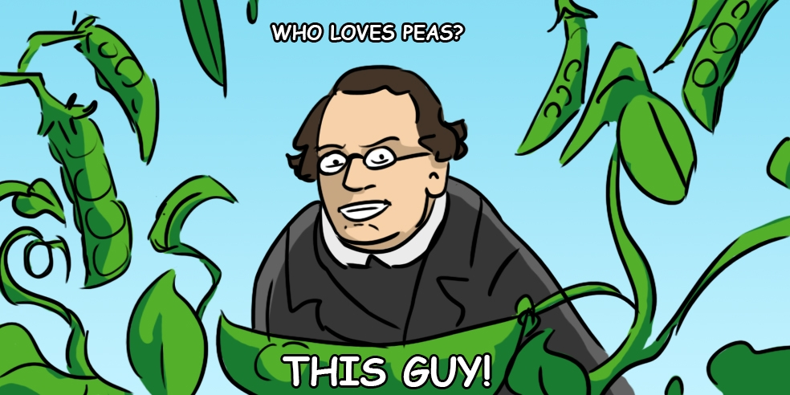
Introduction to Genetics

Slide 2
Intro to Genetics
Today, scientists know how you inherit your traits and are even able to calculate the probabilities of having a specific trait or getting a genetic disease according to the information they have from the parents and family history

Slide 3
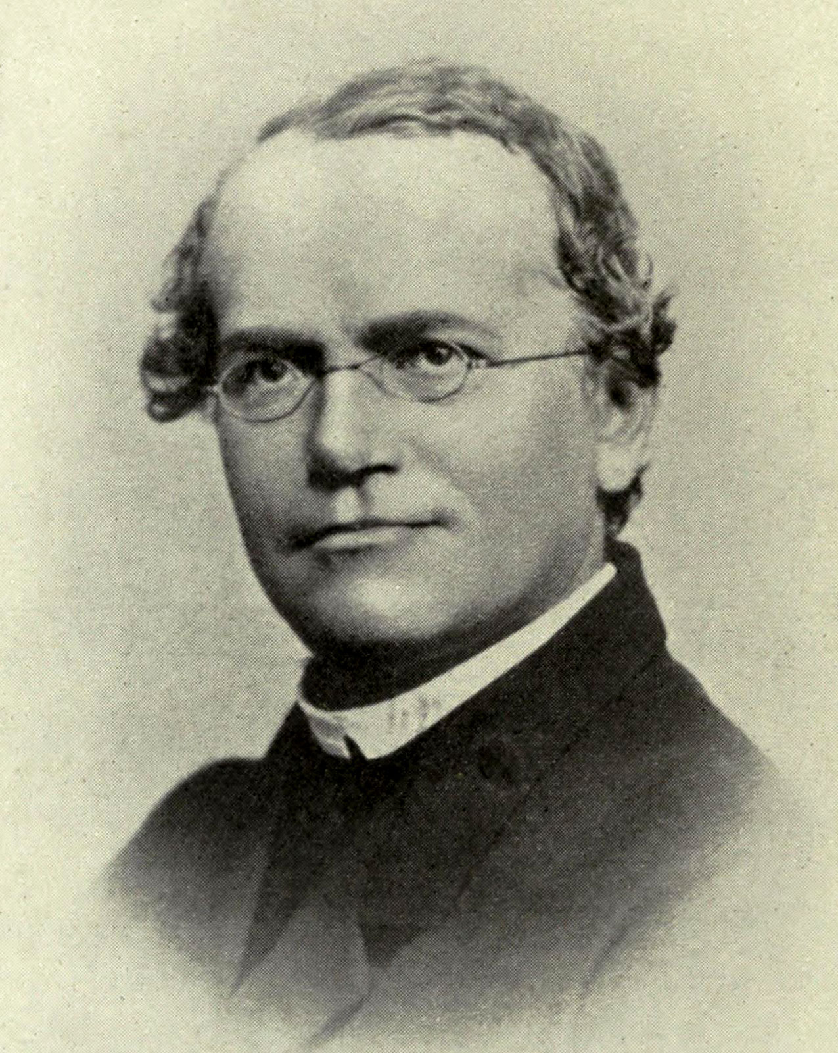
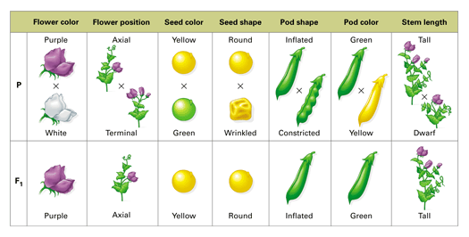
Intro to Genetics
How is this possible?
Between 1856 -1863, Gregor Mendel, an Austrian monk and biologist, grew and studied pea plants
While doing so, Mendel discovered the principles that rule heredity

Slide 4
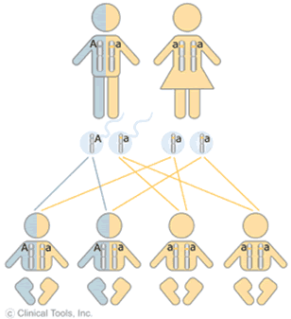
Intro to Genetics
From his experiments, he inferred that each trait depends on a pair of factors, one coming from your mother and one coming from your father
We now know these factors to be called alleles

Slide 5
Intro to Genetics
Allele: a variation of a gene
Ex. Blue vs. brown eyes, curly vs. straight hair
You have 2 alleles for every gene because you have a set of chromosomes from your mother and a set of chromosomes from your father
Gene: a section of DNA that controls a trait
Ex. Eye colour, hair texture

Slide 6
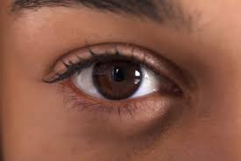
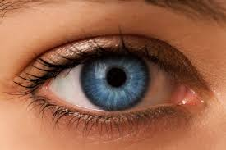
Intro to Genetics
We represent alleles with letters
If the allele is dominant, meaning that it masks the other allele, we use a capital letter for it
E.g. Brown eyes – B
If the allele is recessive, meaning that the trait only shows up if there is no dominant allele present, we use a lower case letter to represent it
E.g. Blue eyes - b

Slide 7
Intro to Genetics
The combination of alleles is known as a genotype
The physical expression of the trait is known as a phenotype

Slide 8
Intro to Genetics
If both alleles are identical, we describe the organism as being homozygous for the trait
i.e. BB or bb
If the 2 alleles are different, we describe the organism as being heterozygous for the trait
i.e. Bb

Slide 9
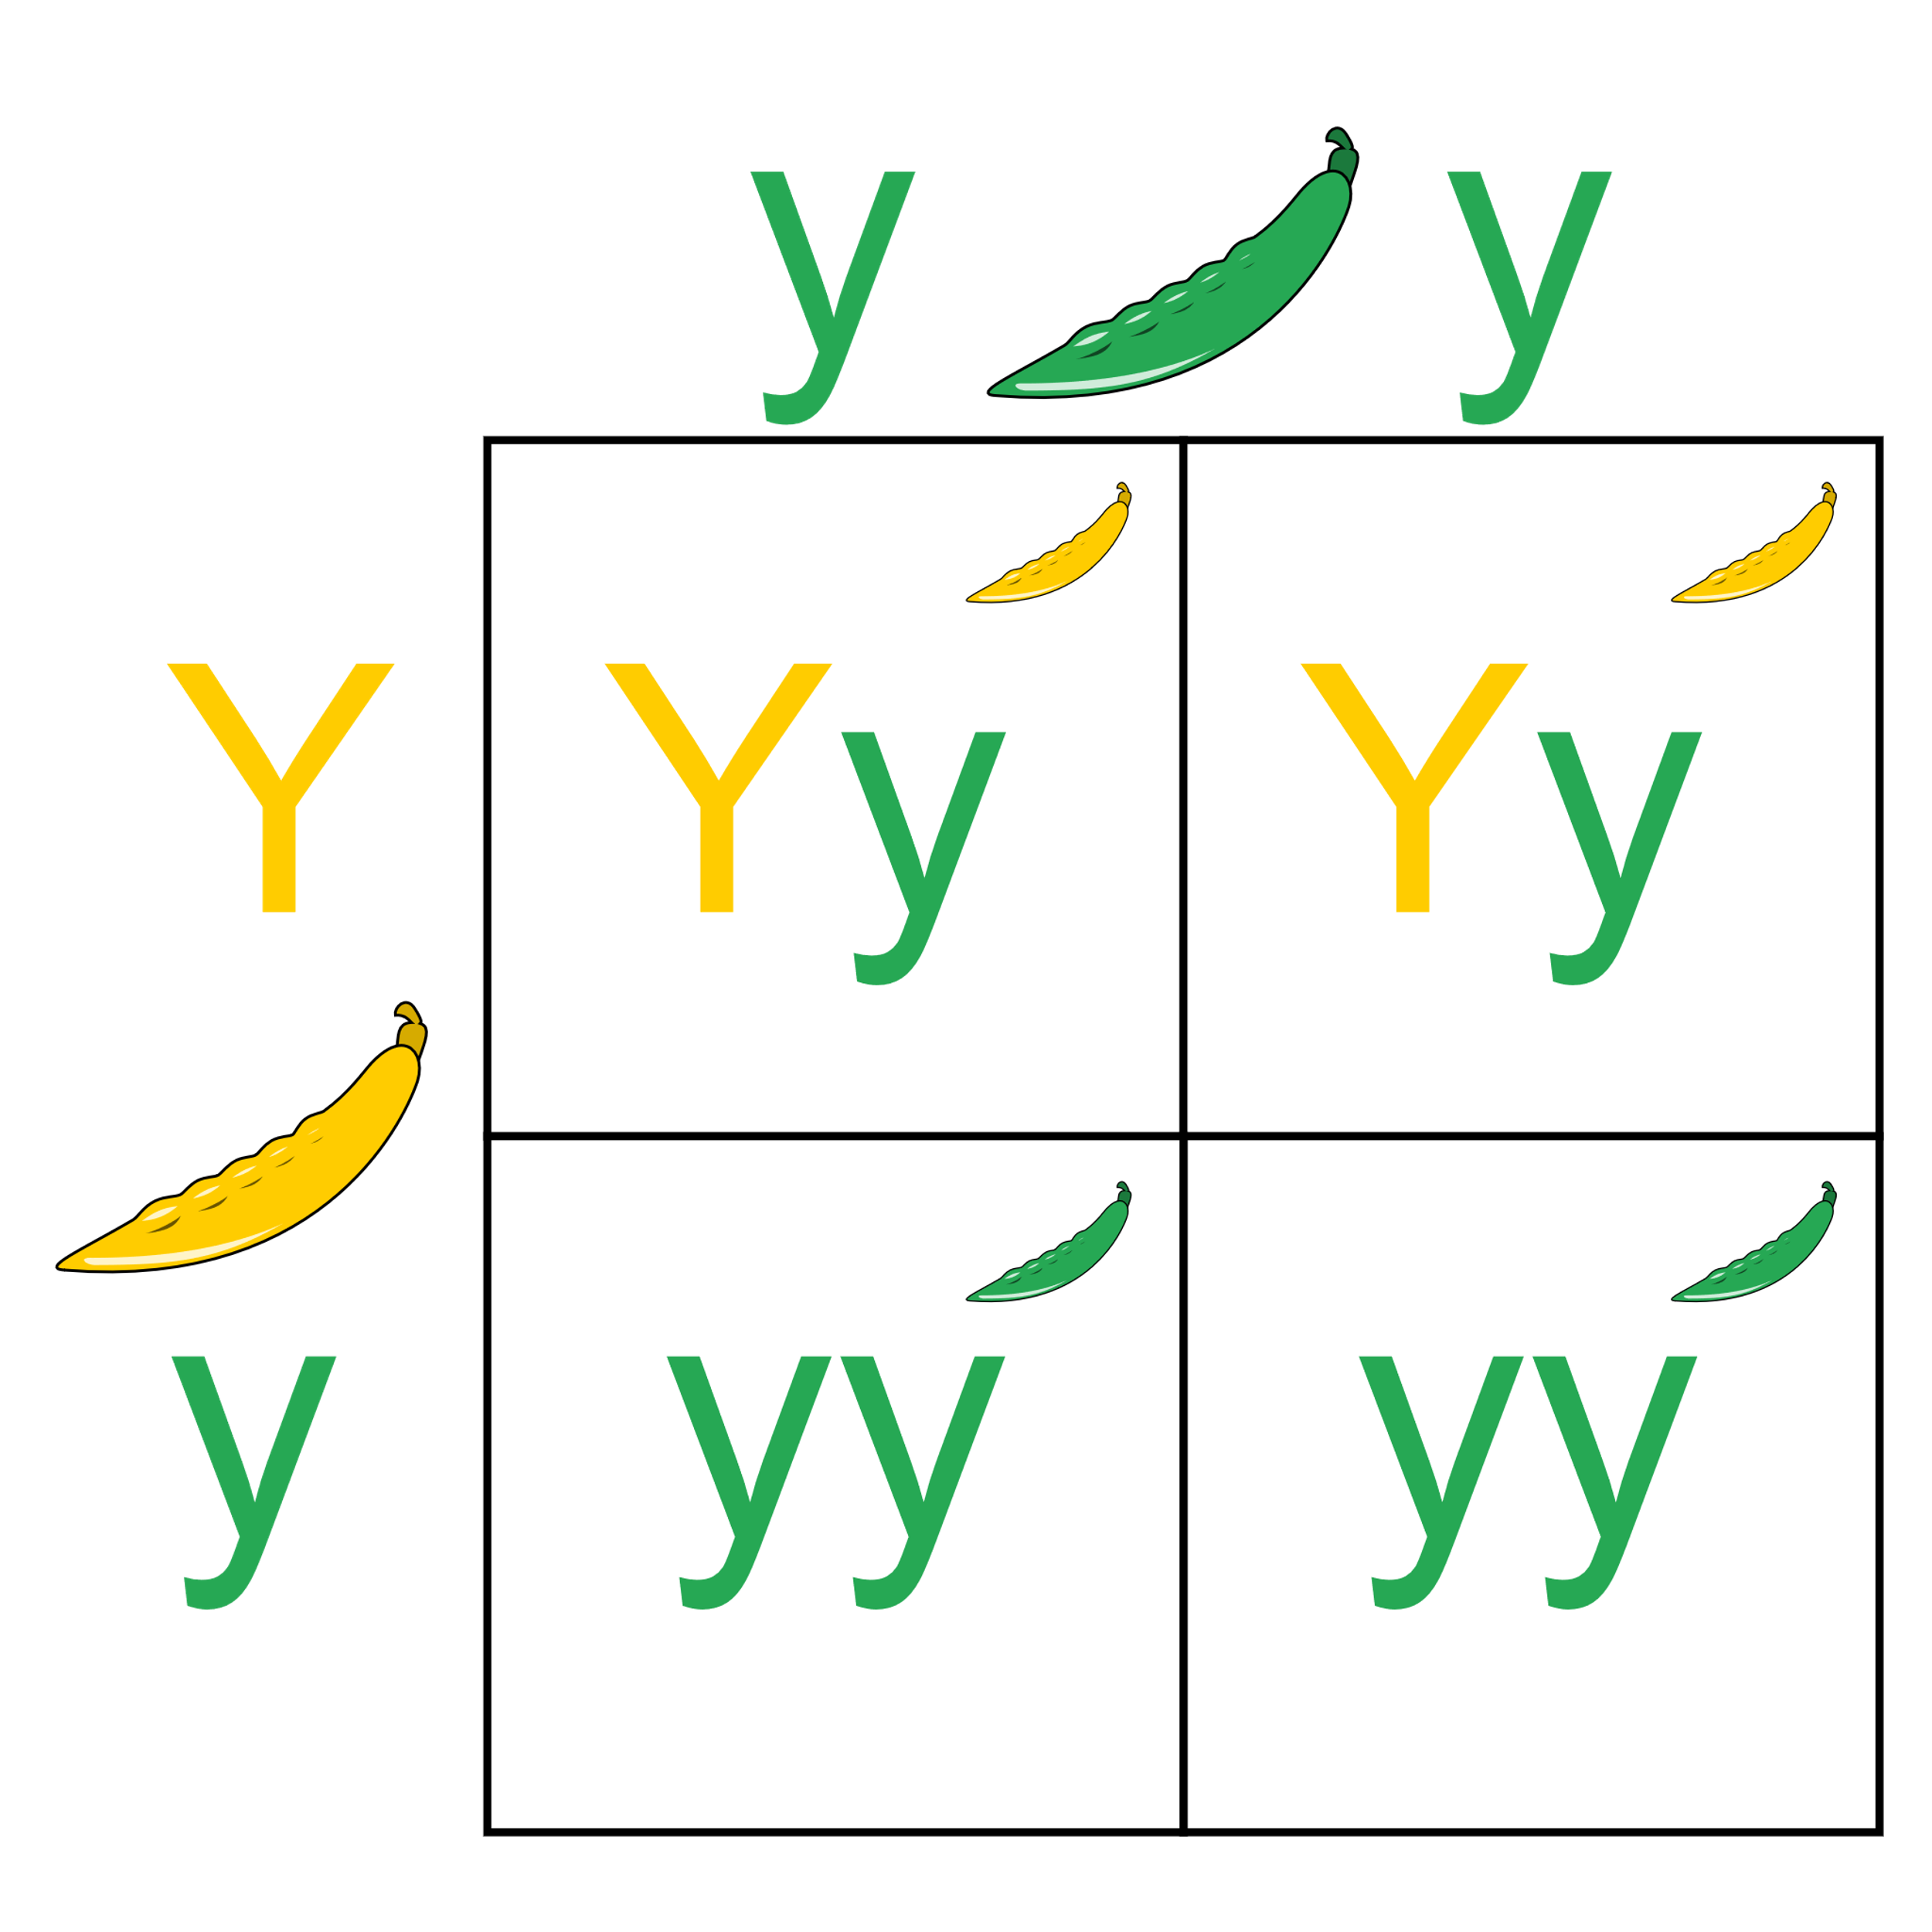
Intro to Genetics
To visualize how alleles are distributed among offspring and predict proportions and probabilities, we use a tool called a Punnett Square

