Slide 1
Earth, Astronomy and the Universe
Grade 9 Science

Slide 2
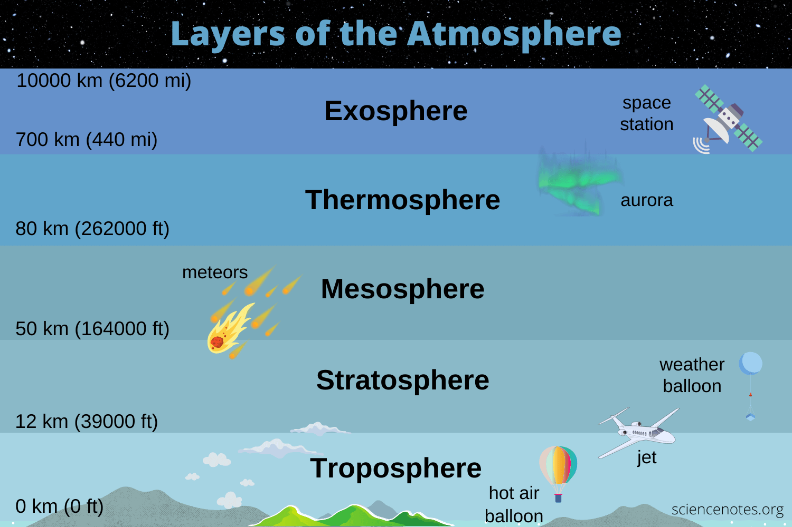
What is Astronomy
Astronomy is the study of anything outside Earth’s atmosphere (approx. 10,000 kms high)
It uses math, physics and chemistry to study celestial objects and phenomena
Celestial- fancy word for outer space or the heavens (ancient Rome)
Objects of interest are, planets, moons, stars, nebulae, galaxies, comets, black holes etc.

Slide 3
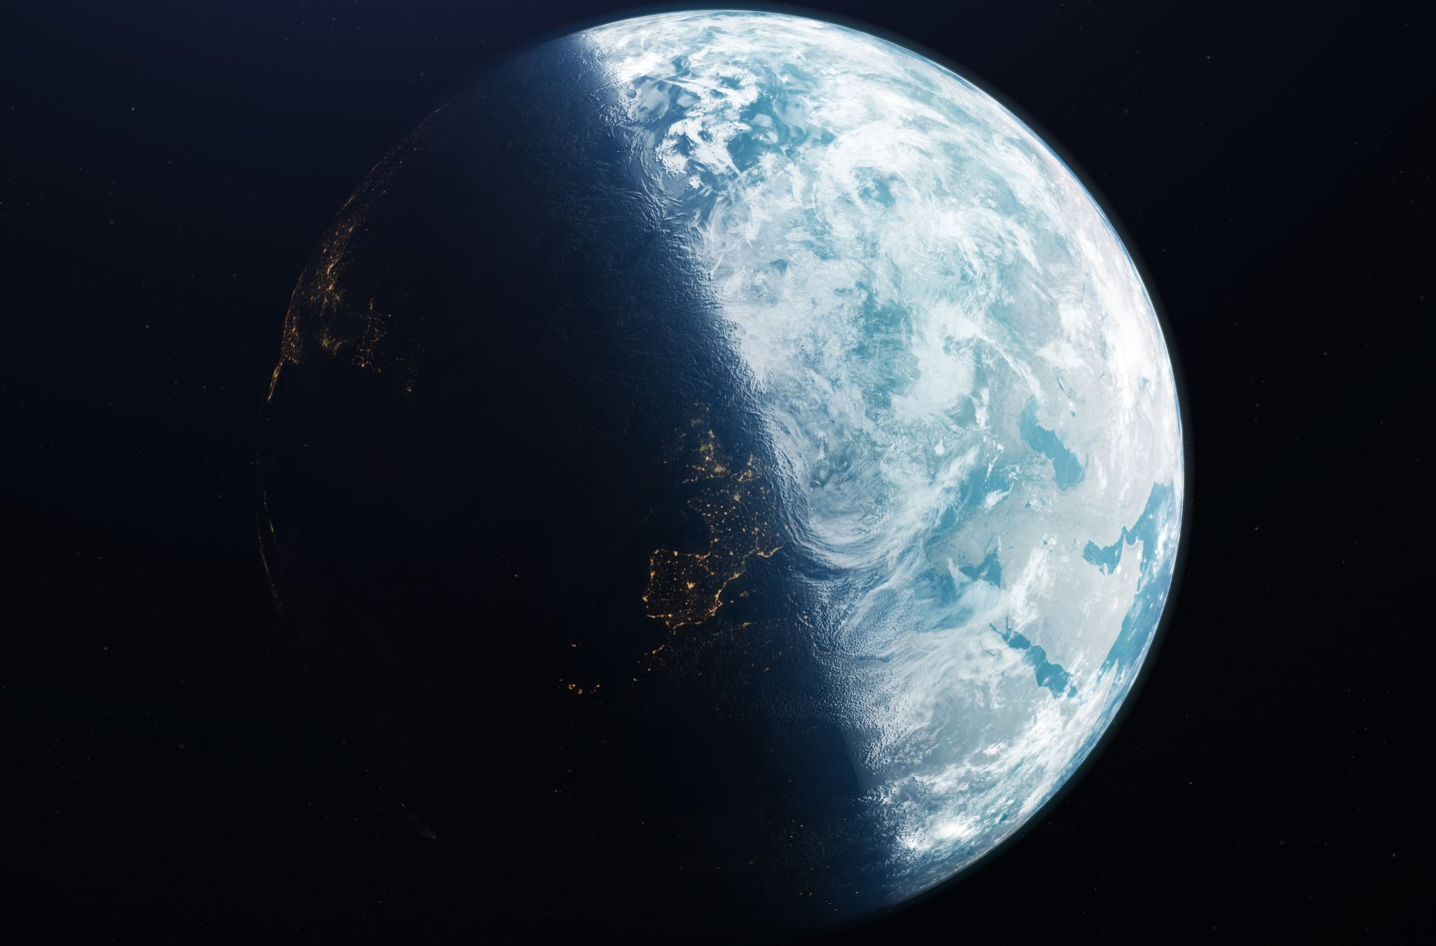
Why is astronomy important
By studying the cosmos beyond earth, we can try to understand the origin of our planet and perhaps where we are going
To study physics and other natural sciences in conditions that are impossible to recreate on earth. For, example, extremely low or extremely high gravity

Slide 4
What is todays Astronomical Significance???

Slide 5
SPRING EQUINOX!

Slide 6
Today’s outline:
1) Watch two short videos on the equinox
2) Answer questions on what was discussed during the video as well as through research
3) We will discuss the answers next class

Slide 7
Links for Day 1
Equinoxes: National Geographic
https://www.google.com/search?q=spring+equinox+video&oq=spring+equinox+video&aqs=chrome..69i57j69i60l3.7801j1j7&sourceid=chrome&ie=UTF-8#fpstate=ive&vld=cid:828e4d4b,vid:kaG6PTVrFP4
Equinox Sun at the South Pole
https://vimeo.com/136274402
Date and Time website
https://www.timeanddate.com/sun/

Slide 8
Latitude and Longitude Video
Video :Latitude and Longitude Andy Jenson
Link: https://www.youtube.com/watch?v=swKBi6hHHMA

Slide 9
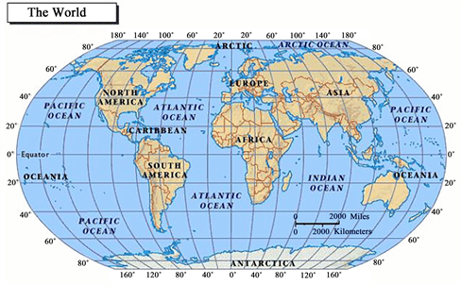
Latitude and longitude
Grid system that helps us find precise locations of things on earth
Cross curricular as it is also a topic of earth sciences
Units used are degrees
(might see minutes and seconds)
Latitude is listed first, then longitude
Ex London England 51.5072° N, 0.1276° W
This Photo by Unknown Author is licensed under CC BY

Slide 10
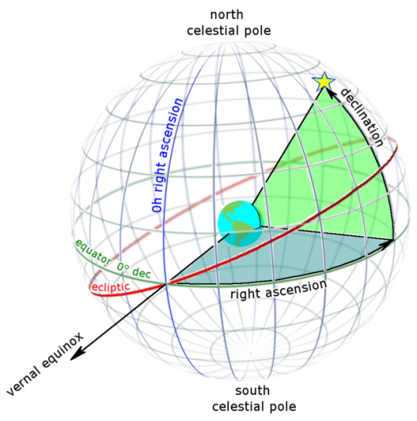
Why is Latitude and longitude important to Astronomy?
Our latitude and longitude grid system helps us locate objects in the celestial sphere
Planets, stars and constellations can all be located using the celestial grid which is based off the latitudes and longitudes of earth
Will also be important when we talk about technologies such as satellites

Slide 11
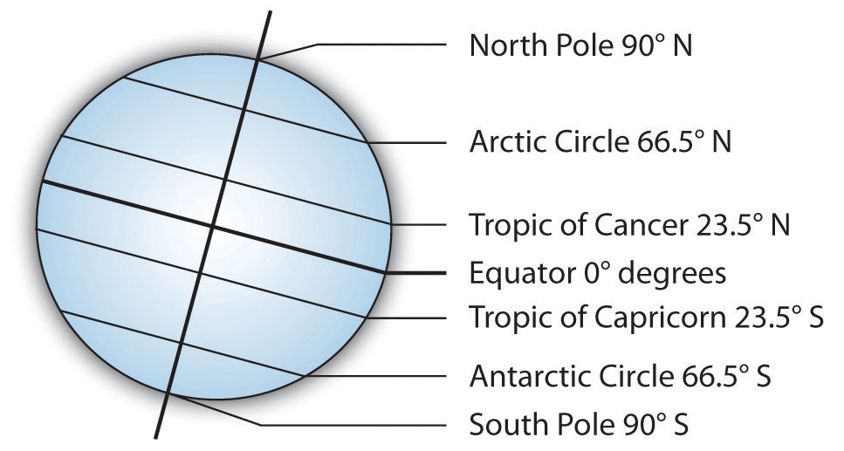
Lines of Latitude
Some important lines of latitude
Also known as “parallels” of latitude
Lines of latitude run east to west and measure how far north or south a location is
The equator is 0 degrees and is the baseline for latitude measurements

Slide 12
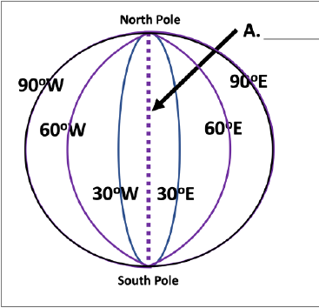
Lines of longitude
Also know as “meridians”
Lines of longitude run north and south and measure how far east and west a location is
The prime meridian is 0 degrees and is the baseline for lines of latitude and longitude
This Photo by Unknown Author is licensed under CC BY-SA-NC

Slide 13
London England
51.5072° N, 0.1276° W
Johannesburg South Africa 26.2041° S, 28.0473° E

Slide 14
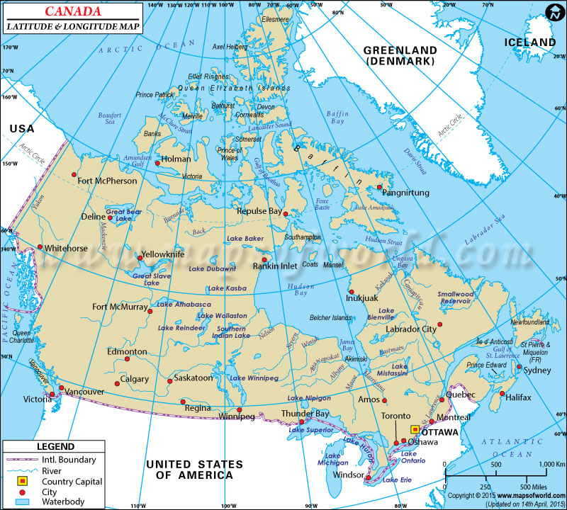
What is the location of Winnipeg?

