Slide 1
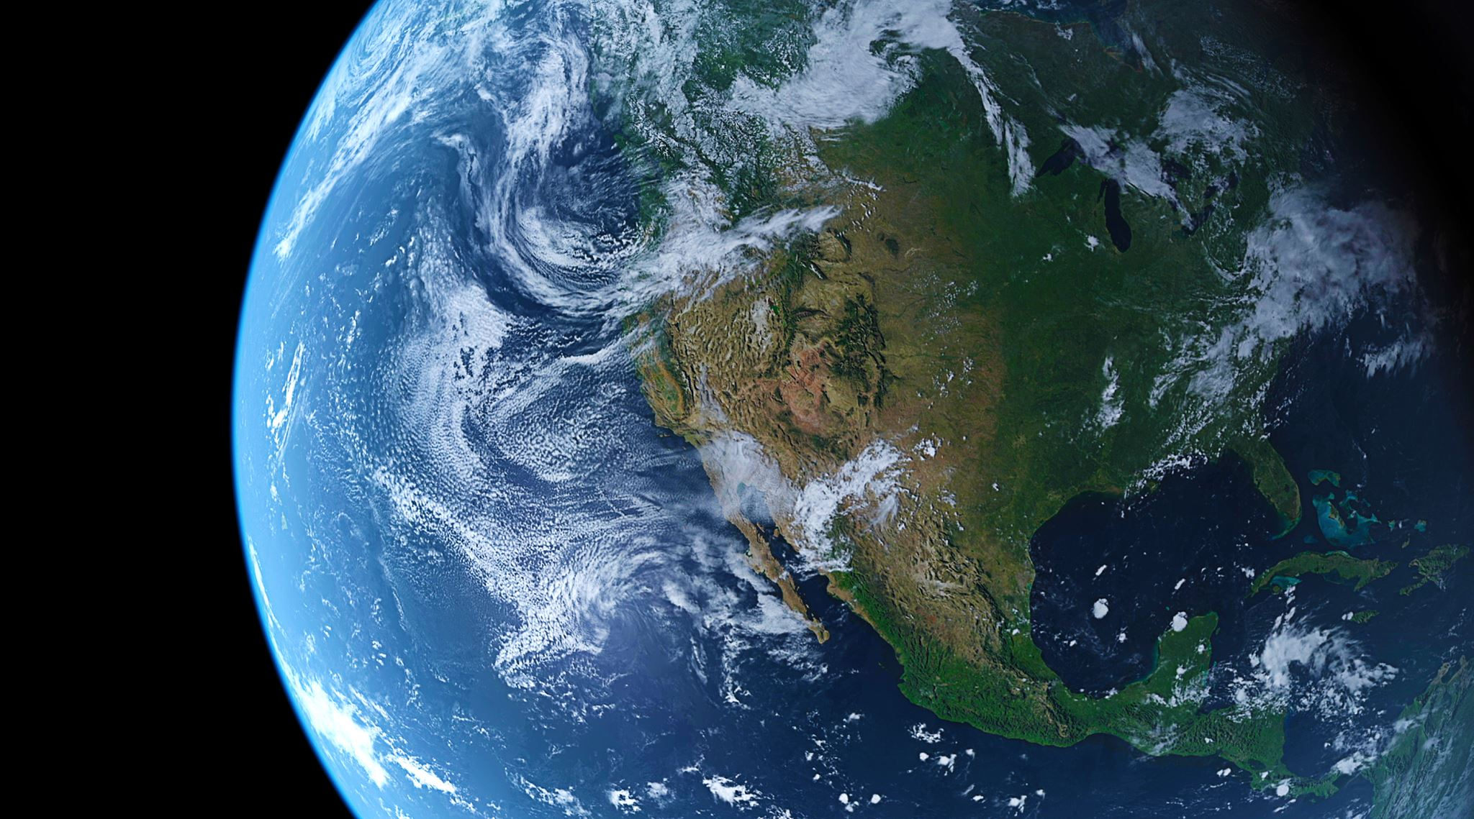
The Earth’s Tilt and Orbit
Grade 9 Science

Slide 2
Why do we have seasons?

Slide 3
Seasons Video
Clip

Slide 4
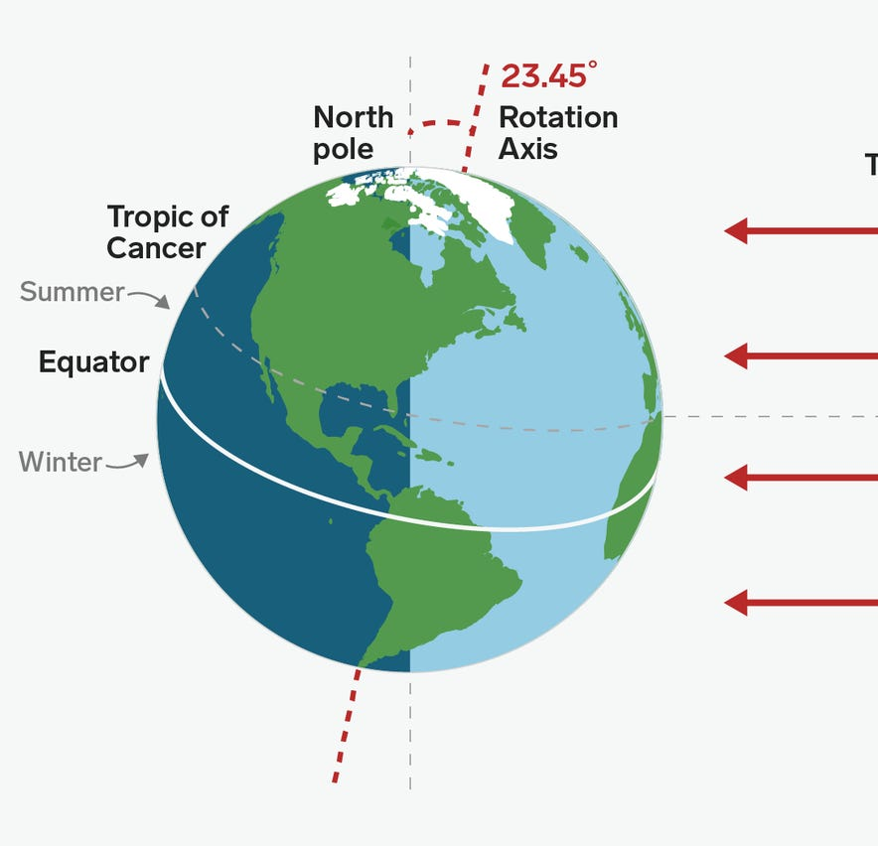
The Earth’s Tilt
The earth is tilted 23.45 degrees on its axis
This tilt is responsible for our seasons
The further you are away from the equator, the more varying the seasons are
In southern Manitoba we have some of the most varying seasons in the world!

Slide 5
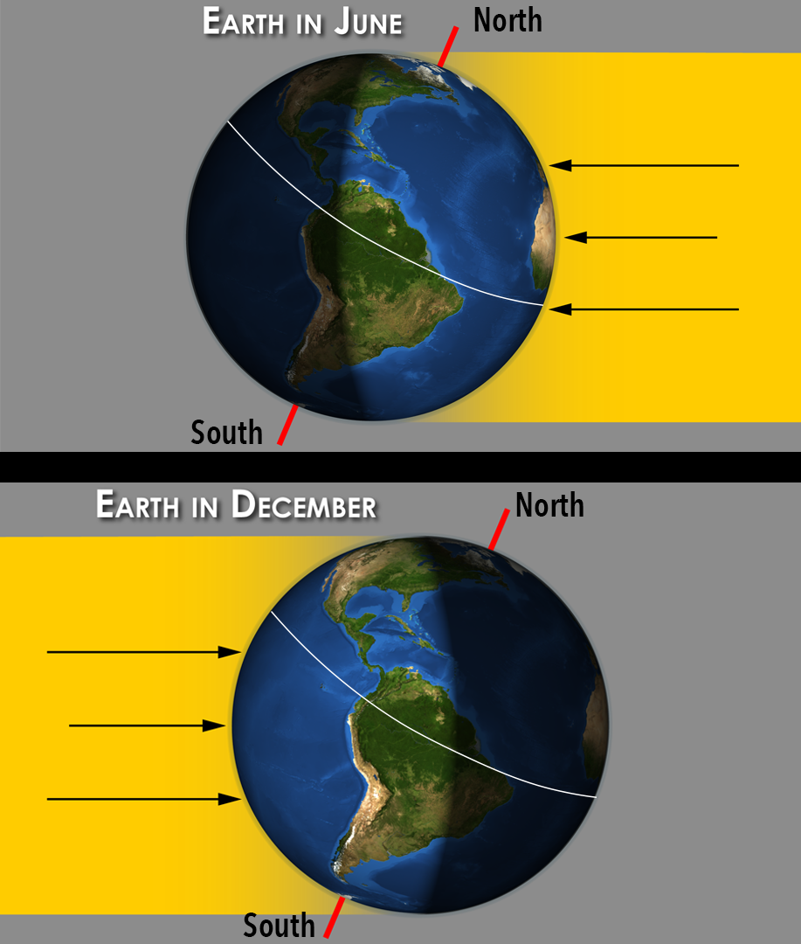
Direct and Indirect sunlight
The sun’s light strikes the northern hemisphere more directly during summer months
And more indirectly during winter
Near the poles, the sun may never set or rise on certain days
Clip

Slide 6
Astronomical Seasons- Northern Hemisphere
Spring: March 21 to June 20
Summer: June 21 to September 20
Autumn: September 21 to December 20
Winter: December 21 to March 20

Slide 7
Astronomical Seasons- Southern Hemisphere
Spring: September 21 to December 20
Summer: December 21 to March 20
Autumn: March 21 to June 20
Winter: June 21 to September 20

Slide 8
The Earth’s Axial Tilt Cycle
The earth’s tilt isn’t constant
It is on a cycle between 22.1 and 24.5 degrees
This 4 sec video represents the movement over a 41,000 year cycle

Slide 9
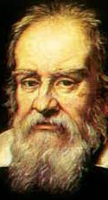
Geocentric View
The geocentric view of the solar system- everything we see in our sky orbits the earth, including our sun
means “earth centered”
Originally proposed by Claudius Ptolemy in the second century CE and stood for more than 1200 years

Slide 10
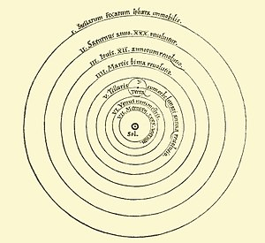
Heliocentric View
Heliocentric view of the solar system is that all the planets, including earth orbit the sun
First proved by Nicolaus Copernicus who was a polish astronomer in the 16th century

Slide 11
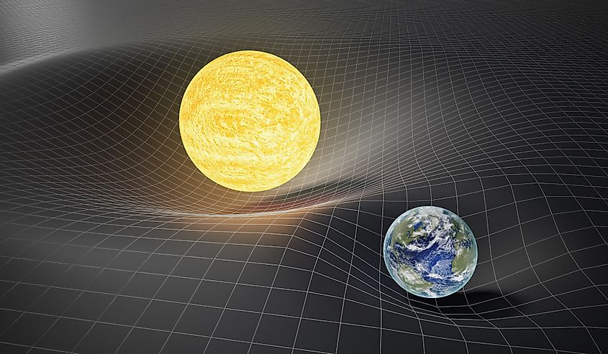
Why does the earth orbit the sun?
All things with mass exert force on one another
The force that the sun has on the earth is called gravity
Gravity or gravitational force is “the force by which a planet or other body draws objects towards its center
The extremely large mass of the sun compared to the earth is why we are orbiting around the sun

Slide 12
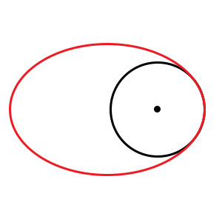
Circle vs Ellipse

Slide 13
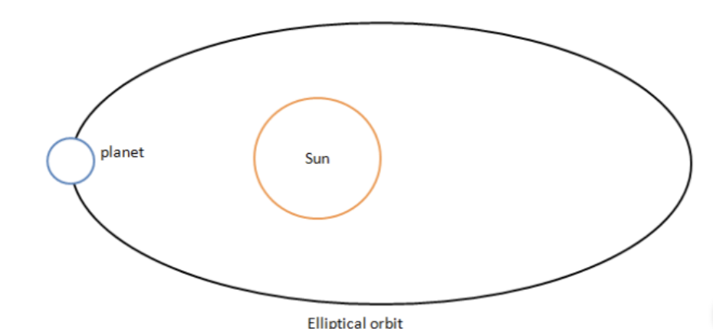
Earth’s Elliptic Orbit
When looking at earth’s orbit around the sun, it is not a perfect circle
It is a slight ellipse
Notice that the sun is not directly in the middle of an elliptical orbit

Slide 14
Earth’s Elliptic Orbit
The earths average distance from the sun is 149,600,000 km’s
This distance varies by 5,100,000 kms due to the elliptic shape of earth’s orbit (difference of 3.4%)
This difference causes the length of seasons to be slightly different
Kepler’s 2nd law of planetary motion states that a line segment joining a planet and the sun sweeps out equal areas during equal intervals of time
Although it doesn’t feel like it, winter is 4.5 days shorter than the summer in the north hemisphere. Spring is also is 3 days longer than fall
Kepler's 2nd Law Clip

Slide 16
Eccentricity
Eccentricity is a measurement of how elliptic an orbit is
The eccentricity of earth’s orbit is currently .0167
However, this number isn’t constant, earth’s eccentricity varies between 0.0034 (most circular) to 0.058 (most elliptic) over a roughly 100,000 year cycle
This variation is caused by gravitational pull from other planets

Slide 19
Ice Ages
-There are many components of that go into why ice ages occur but the variability in the earths tilt and its orbit are the main reasons why an ice age or “glacial period” occurs approximately every 100,000 years
Last ice age ended approximately 25,000 years ago
Next ice age will likely be delayed due to global warming

Slide 20
Annie Cannon

Slide 21
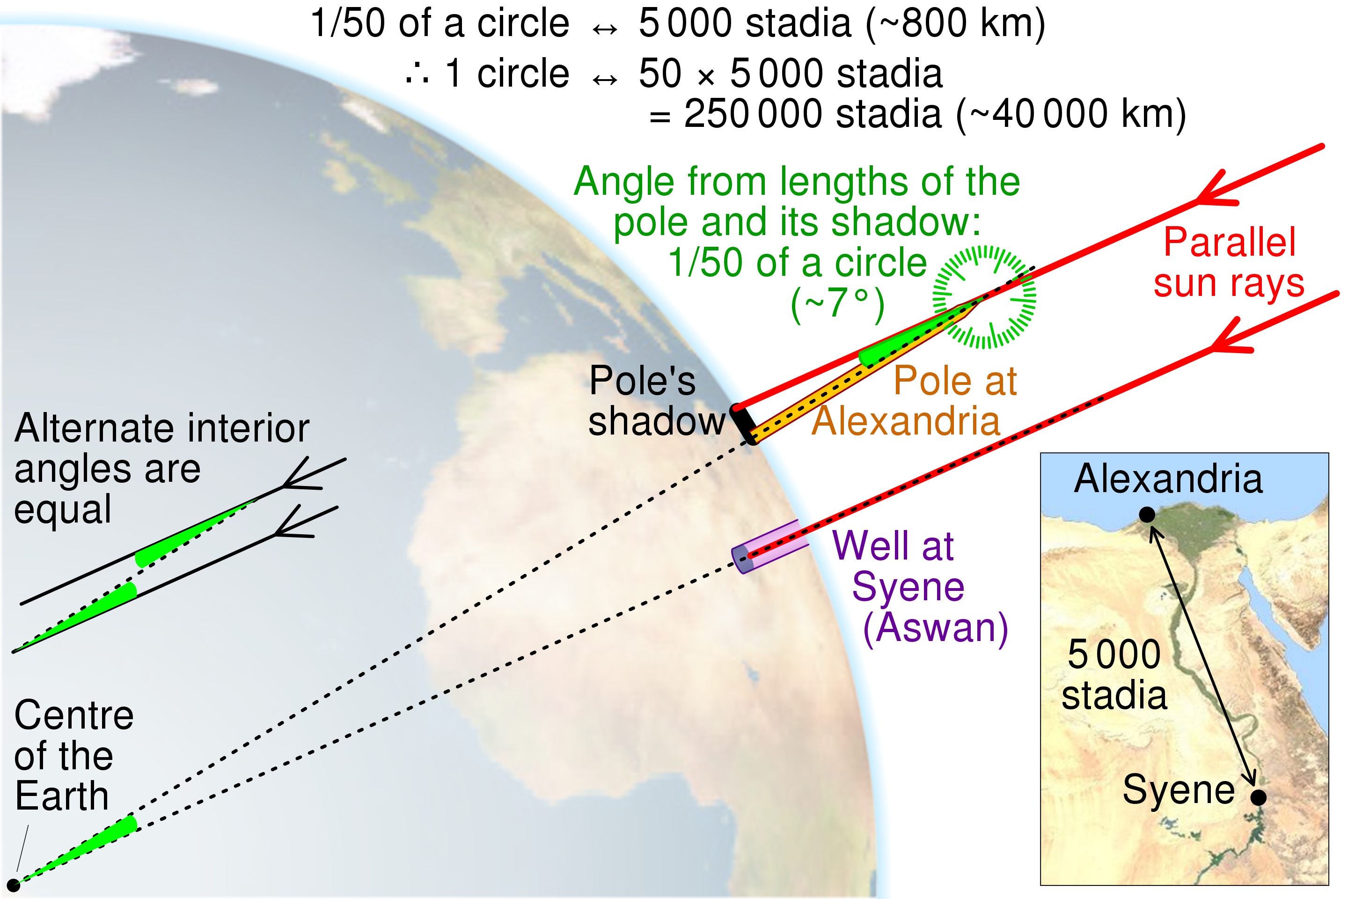
Eratosthenes of Cyrene
276-195 B.C.
Greek mathematician, astronomer and geographer
Major Contribution: One of the few of his time that believed the earth was round and used the sun to measure the size of the earth.

Slide 22
Albert EInstein

Slide 23
Stephen Hawking

Slide 24
moon
Tides
Eclipses
Moon cycle

Slide 25
Celestial motion for navigation

Slide 26
sun

Slide 27
North star
The north star is called “Polaris”
It is the last star on. The handle of the Little Dipper Constellation
You can find it by using the last two stars on the big dipper, they point directly to Polaris

Slide 28
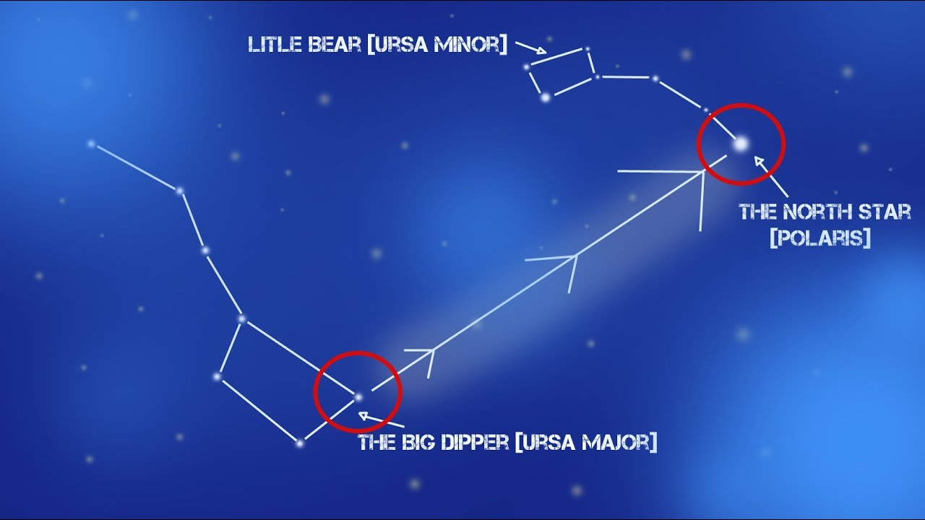

Slide 29
Why is the north Star always north
The north star is always north because it is so close to the celestial North pole
The celestial north pole refers to the point in the sky that is directly about the earth’s north pole (

Slide 30
References
https://climate.nasa.gov/news/2948/milankovitch-orbital-cycles-and-their-role-in-earths-climate/#:~:text=Earth's%20axis%20is%20currently%20tilted,about%209%2C800%20years%20from%20now.

