Slide 1
DNA and Heredity

Slide 2
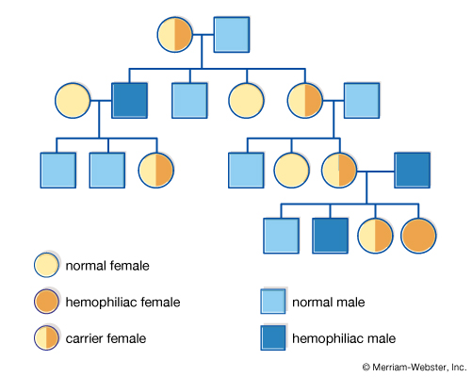
DNA and Heredity
You have learned that offspring produced through sexual reproduction inherit a combination of both parent's characteristics
Heredity is the passing on of characteristics from one generation to the next

Slide 3
DNA and Heredity
A characteristic is a feature such as eye colour or wing shape
A trait is a variation of a characteristic such as brown versus blue eye colour or long versus round wing shape

Slide 4
DNA and Heredity
Your DNA or deoxyribonucleic acid is the material that determines how traits are passed from one generation to the next
When this was discovered, it led to a new question: How could the blueprint for so many different organisms be passed on by what seemed to be the same molecule?

Slide 5
DNA and Heredity
Solving this problem was one of the greatest scientific achievements and it was accomplished by 2 scientists, James Watson and Frances Crick. They discovered that:
The DNA molecule has a structure that resembles a twisted ladder, known as a double helix

Slide 6
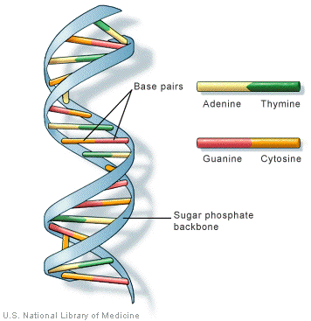
DNA and Heredity
The sides of the ladder are identical, but the rungs vary
Each rung pairs up 2 of the following 4 chemicals: guanine (G), cytosine (C), adenine (A) and thymine (T)
Guanine can only pair with cytosine
Adenine can only pair with thymine
E.g. SEE BOARD

Slide 7
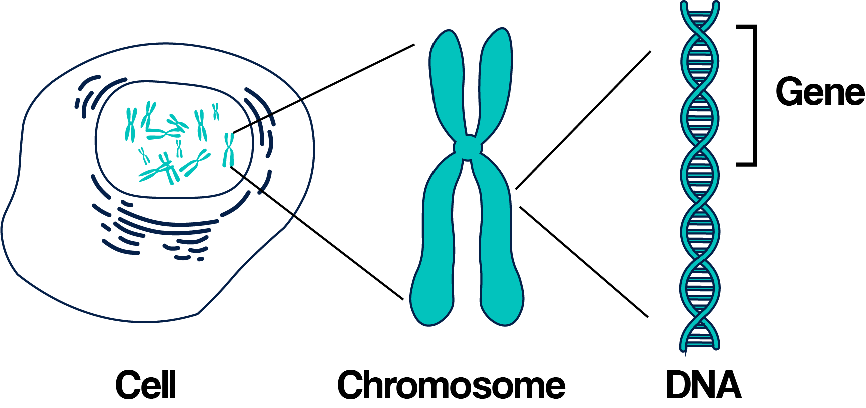
DNA and Heredity
Your genetic code is based on the arrangement of these 4 chemical “letters” into “words”
These “words” code for your genes

