Slide 1
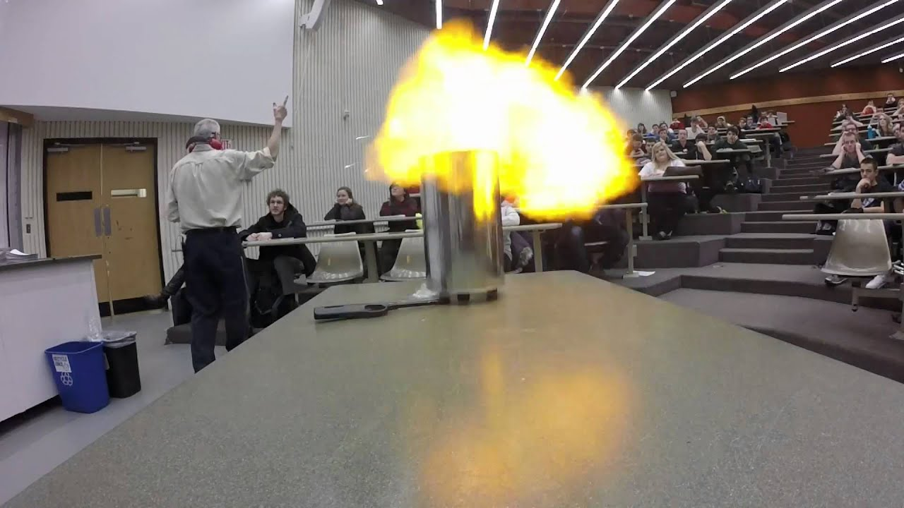
Hydrogen (special properties)
Sometimes hydrogen behaves like a metal, other times like a non-metal (in terms of what elements it will combine with)
Highly reactive and is diatomic – H₂

Slide 2
Hydrogen
https://www.youtube.com/watch?v=cxFb4hmfVT0

Slide 3
Chalcogens (6A)
Also known as the Oxygen Family
Main elements are: Oxygen and sulfur (both non-metals)
Slightly less reactive than the halogens

Slide 4
Chalcogens (6A)
All chalcogens have 6 electrons in their outer shell, so the preferred state is to gain 2 electrons to form double charged negative ions, -2

Slide 5
Halogens (7A)
Main elements are: Fluorine, Chlorine, Bromine and Iodine
Halogens are very highly reactive, especially with metals to form salts, or with Hydrogen to form acid

Slide 6
Halogens
Also exist as diatomic molecules: F₂, Cl₂, Br₂ and I₂
Due to their reactivity, they are found combined with another element when in their natural state
Halogens have 7 electrons in their outer shell, so their preferred state is to gain 1 more electron to form a single charged negative ion, -1

Slide 7
Halogens
Comparing the four halogens - Chemical elements: properties and reactions (2/8) – YouTube
Sodium and Halogens Explosive Reactions! | Chlorine, Bromine, Iodine – YouTube
Reacting Fluorine with Caesium - First Time on Camera - YouTube

Slide 8
Nobel Gases (8A)
Main elements are: Helium, Neon, and Argon
Chemically stable and unreactive because their outer valence shell is completely filled with electrons
Very low melting and boiling points, so all are gases at room temperature

Slide 9
Noble Gases
"Noble Gases" | SUNG SCIENCE - YouTube

