Slide 1
Chemical Reactivity and Chemical Families

Slide 2
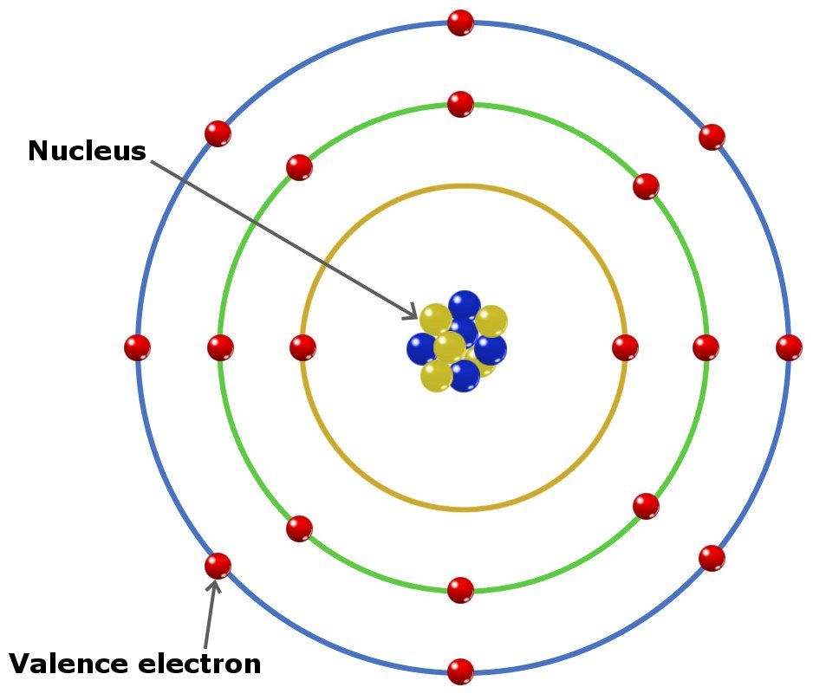
Chemical Reactivity
The chemical reactivity of an element is determined by the number of electrons in its outer shell or orbit
These are known as
valence electrons

Slide 3
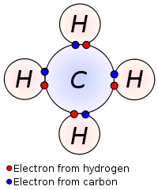
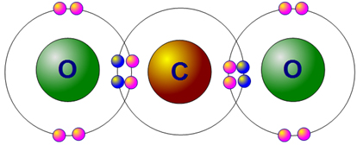
Chemical Reactivity
Atoms (except those of the noble gases) will gain, lose, or share electrons in order to fill their outer shell (i.e. achieve 8 valence electrons) and become structurally and chemically stable

Slide 4
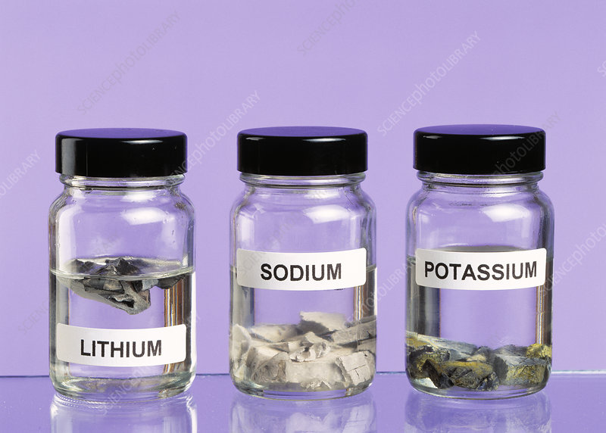
Chemical Families
Alkali Metals (1A)
Main elements of interest are: Lithium, sodium, and potassium
All are highly reactive and therefore are never found in nature as the elemental form

Slide 5
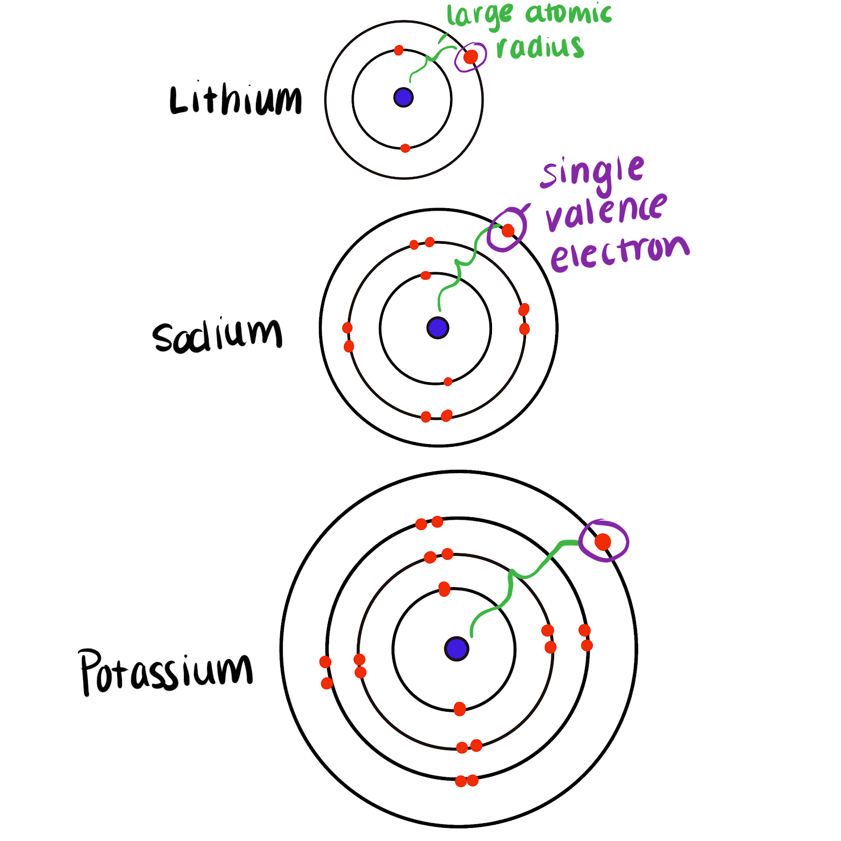
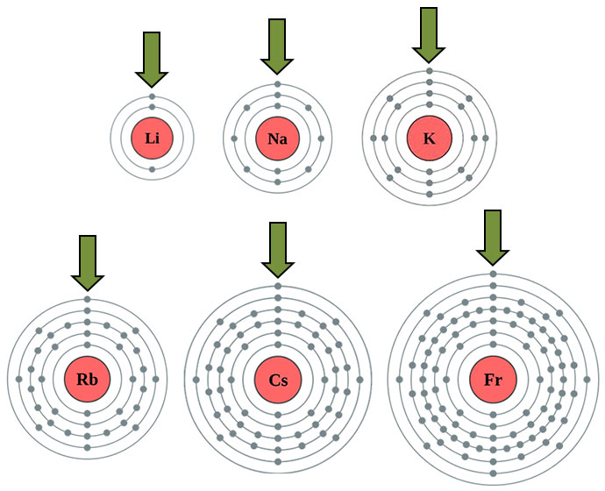
Alkali Metals
These elements are highly reactive because of the single electron found in their valence shell

Slide 6
Alkali Metals
Common characteristics are: shiny, silver coloured, low melting/boiling points, malleable (soft), low densities, react readily with non-metals (particularly halogens)
All the alkali metals have 1 electron in their outermost shell, so the preferred state is to lose 1 electron to form a single positive ion, +1 (cation)

Slide 7
Alkali Metals
Alkali metals in water - Chemical elements: properties and reactions (1/8) - YouTube,
Brainiac Alkali Metals – YouTube
Mythbusters - YouTube

Slide 8
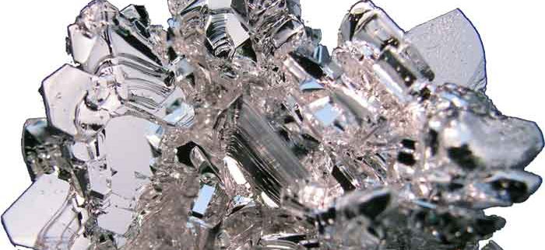
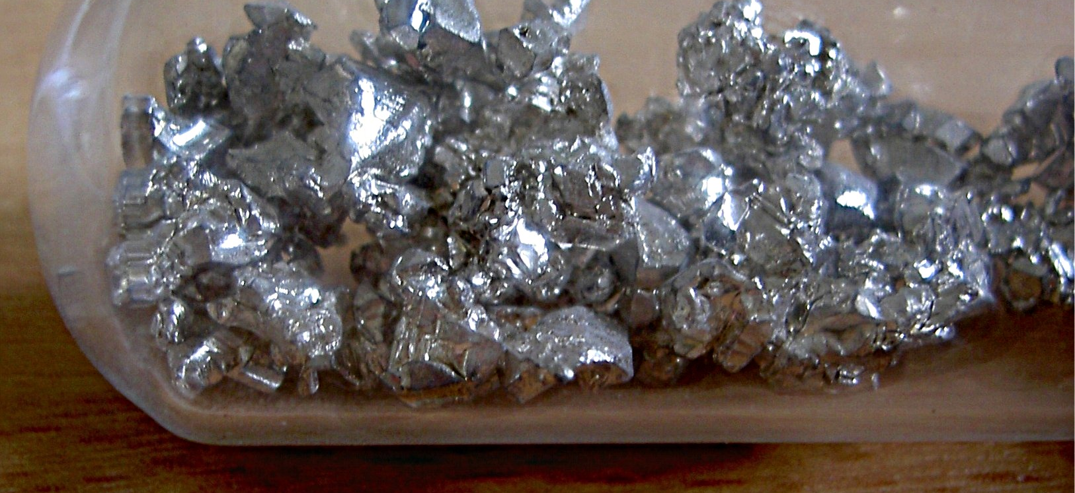
Alkaline Earth Metals (2A)
Main elements are: Magnesium and Calcium
Still very reactive but not as much as the alkali metals

Slide 9
Alkaline Earth Metals
Common characteristics are: silver coloured, soft, low-density metals, react readily with halogens
All the alkaline earth metals have 2 electrons in their outermost shell, so the preferred state is to lose 2 electrons to form double charged positive ions, +2
Video 1, Video2, Video 3, Video 4

Slide 10
Alkaline Earth Metals
clip - Alkaline earth metals (5) - YouTube

