Slide 1
Cell Structures and Functions
Cells are like factories in which the business of life is always going on
To carry out these activities, cells have basic structures in common
These structures are known as organelles
Each organelle has a specific role in the activities necessary for life

Slide 2
Cell Membrane
Surrounds and protects the contents of the cell
Is selectively permeable, meaning it controls the movement of materials into and out of the cell

Slide 3
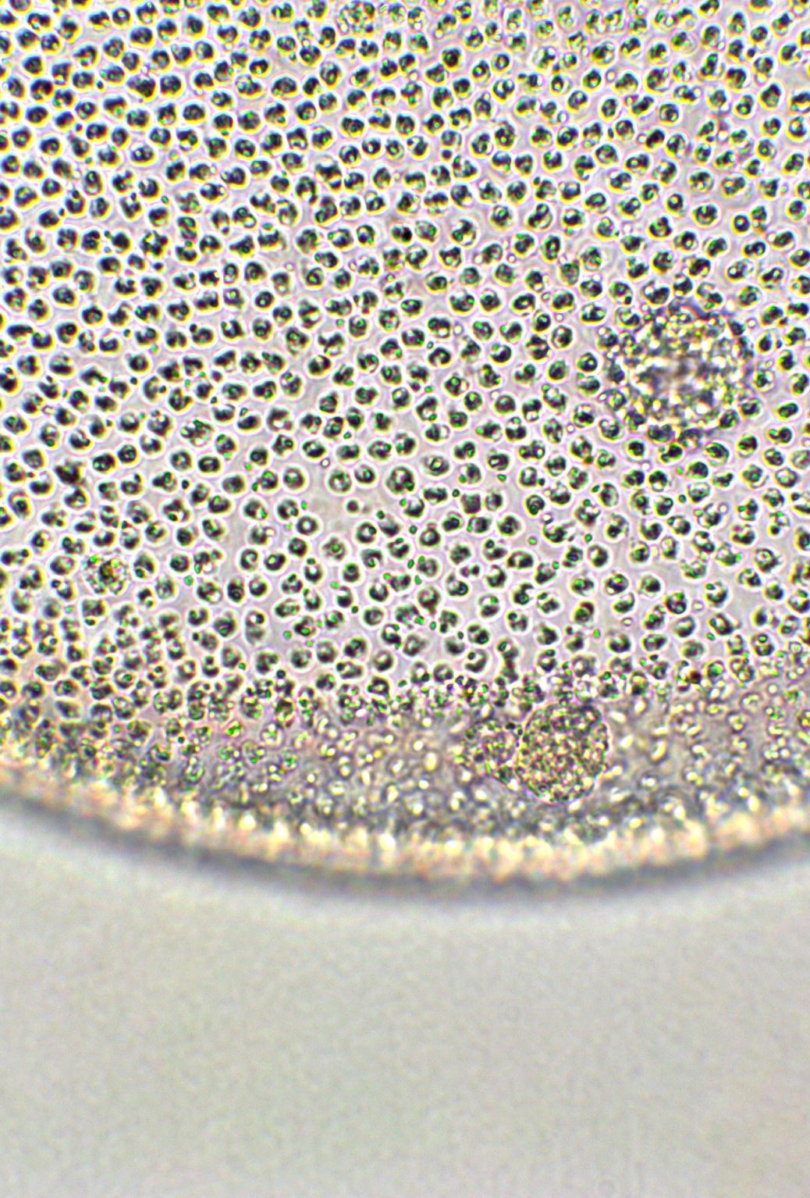
Cytoplasm
Jelly like substance that fills up the cell
Supports the cell structures
Because it is fluid and constantly moving like blood, it distributes materials such as oxygen and food to different parts of the cell

Slide 4
Nucleus
Largest organelle
Controls the cell’s activity (control centre)
Contains chromosomes (DNA), genetic material that directs a cell’s growth
Surrounded by a nuclear membrane
Contains the nucleolus – it makes ribosome parts

Slide 5
Vacuoles
Storage places for extra food, water, wastes, and other substances the cell cannot use right away
Animal cells have many small vacuoles, plants have one large central vacuole

Slide 6
Ribosomes
Make proteins
Can be found in the cytoplasm or attached to the endoplasmic reticulum

Slide 7
Endoplasmic Reticulum
Folded membrane that forms a system of canals within the cytoplasm
Materials are transported through these canals to different parts of the cell or to outside of the cell.
Some of the ribosomes are attached to the endoplasmic reticulum

Slide 8
Mitochondria
Transform energy
Powerhouse of the cell
Breakdown food to release energy for the cell’s activities

Slide 9
Golgi Bodies
Package useful materials, such as proteins and lipids, and secrete them to the outside of the cell for use elsewhere in the organism

Slide 10
Lysosomes
Breakdown food, wastes, and worn-out cell parts

Slide 11
Cell Wall
Only found in plant cells, fungi, and some unicellular organisms
Located just outside the cell membrane
Thick and rigid and made mostly of a tough material called cellulose
Provides support for the cell

Slide 12
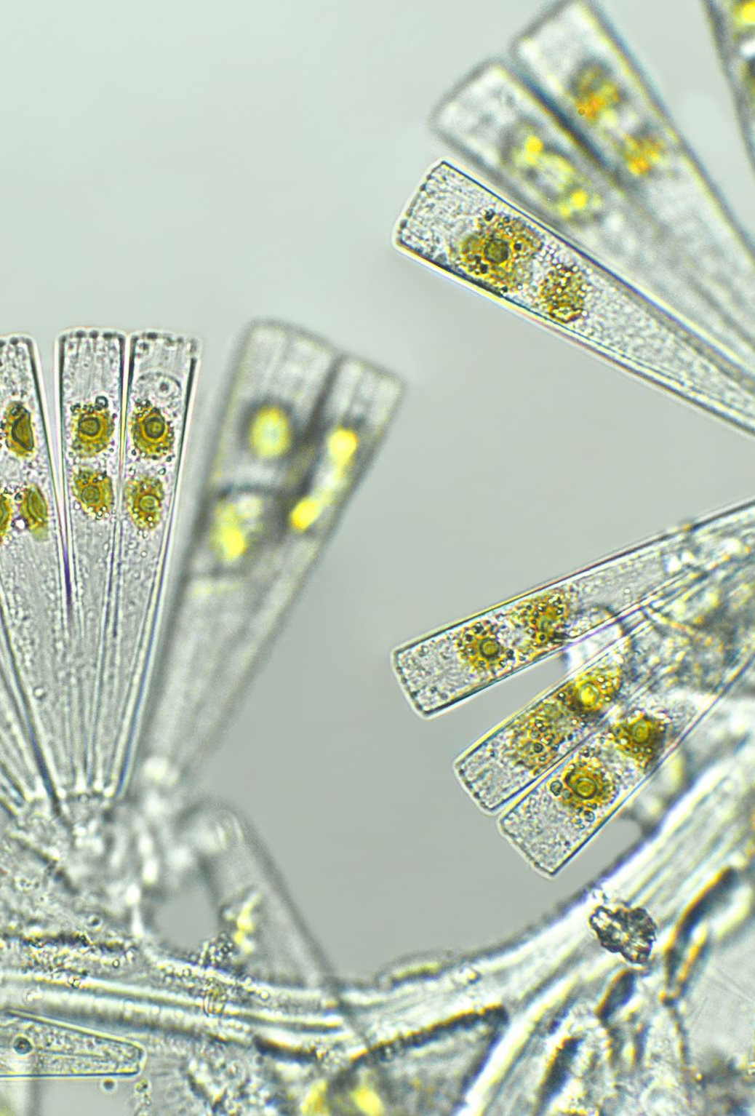
Chloroplasts
Only found in plants and some unicellular organisms; not in animal cells
Contain the green pigment chlorophyll, which absorbs sunlight
Is where photosynthesis takes place (i.e. convert light energy to usable chemical energy)

