Slide 1
Asexual Reproduction

Slide 2
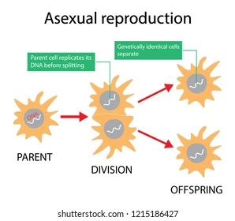
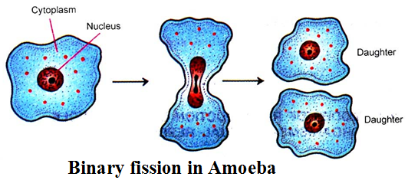
Asexual Reproduction
Asexual reproduction is reproduction that involves only 1 parent

Slide 3
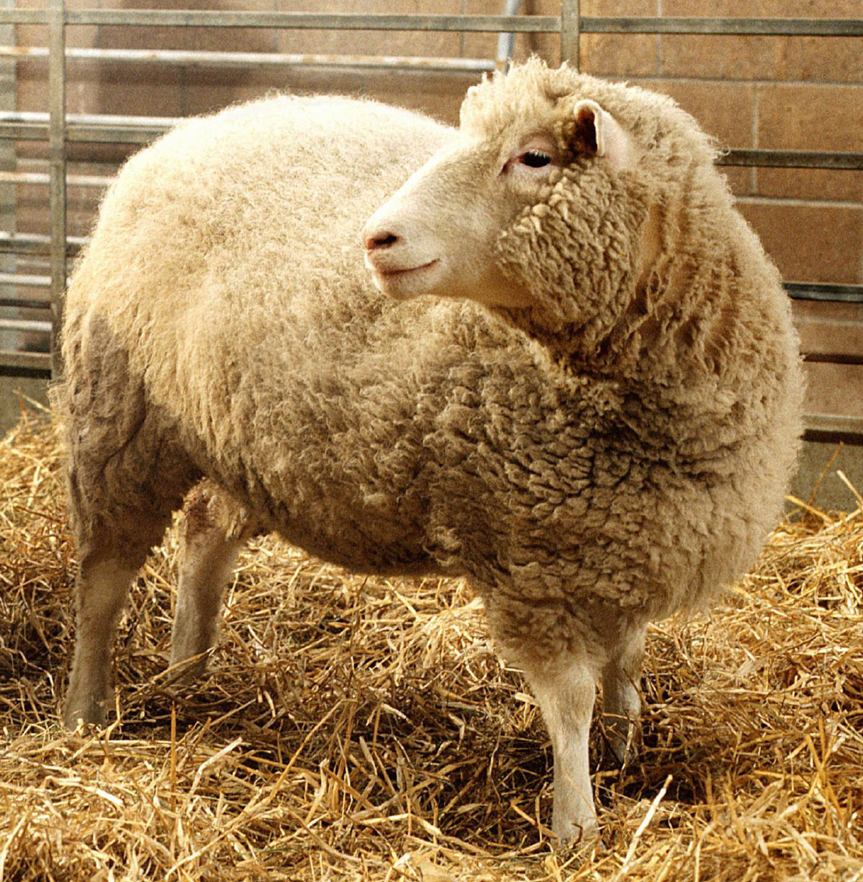
Asexual Reproduction
All of the offspring that are produced are genetically identical to the parent because the parent makes an exact copy of itself
i.e. the offspring is a clone of the parent

Slide 4
Asexual Reproduction
In some cases, asexual reproduction can produce a lot of identical individuals quickly
E.g. in a 12 hour period a single bacterium can divide to produce millions of copies of itself
https://www.youtube.com/watch?v=KIpcCyuypzg

Slide 5
Asexual Reproduction
If the organism’s environment doesn’t change much, this can be a huge advantage
However, it can also be a disadvantage because any factor that negatively affects the parent will also negatively affect ALL of the offspring

Slide 6
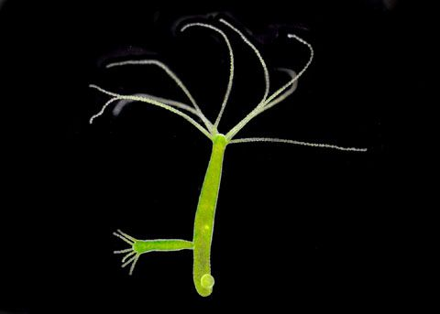
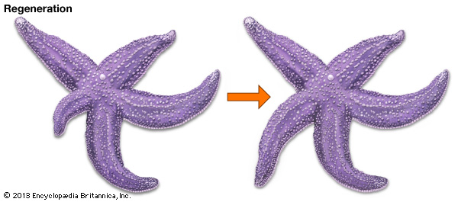
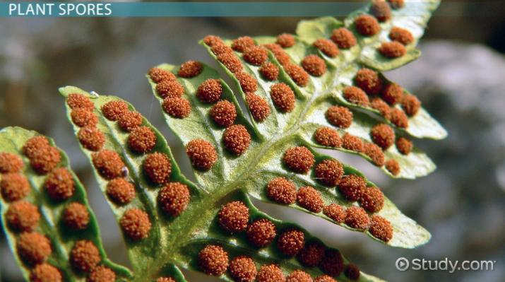
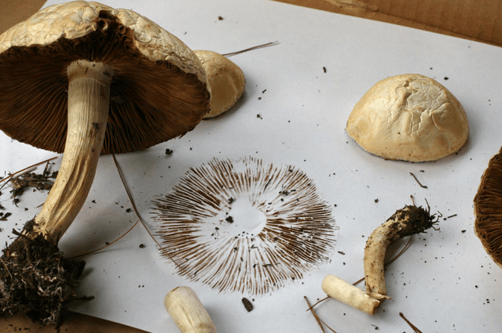
Asexual Reproduction
Here are some specific types of asexual reproduction that we will be looking at more closely:
Binary fission
Budding
Regeneration
Spores

Slide 7
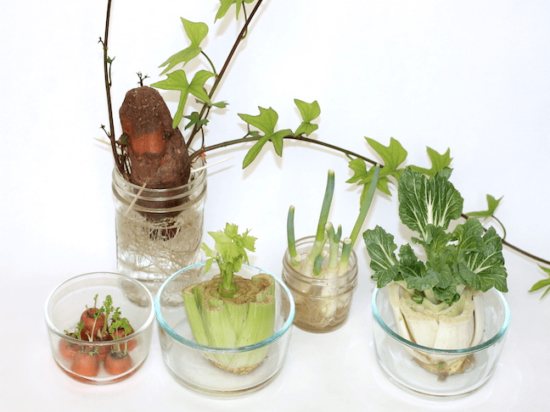
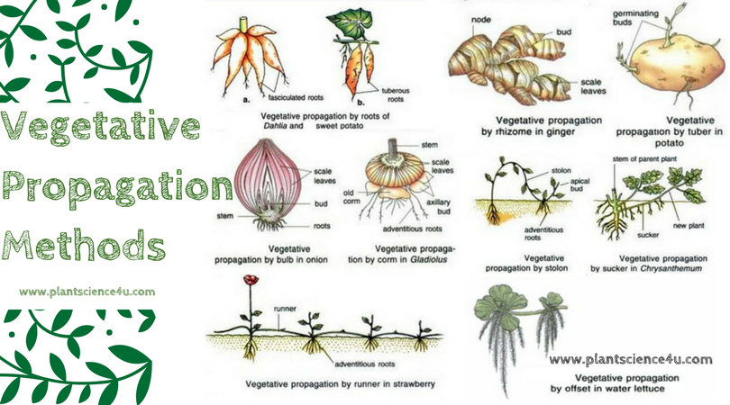
Asexual Reproduction
Vegetative propagation

